Slide 1

“Neutron lifetime measurements: status and prospects”
Victor Ezhov,
NRC «Kurchatov Institute» - PNPI
8.06.2023

Slide 2

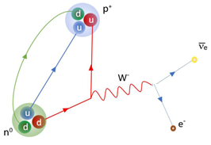
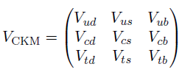
β decay and Standard Model
Matrix element V_{ud} is responsible for the beta decay of the neutron According requirement of unitarity the first row of V_{CKM} must satisfy
|V_{us}| = 0.2243 ± 0.0008
Since |V_{ub}|² =1.7 × 10⁻⁵ is negligibly small, it is ignored in this discussion
Values of V_{ud} have been obtained from nuclear, neutron, and pion beta decays
The most precise determination of |V_{ud}| comes from the study of superallowed 0 + → 0 + nuclear beta decays, which are pure vector transitions.

Slide 3
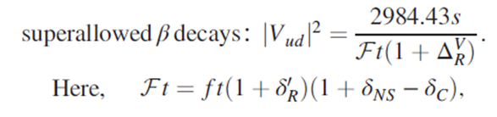
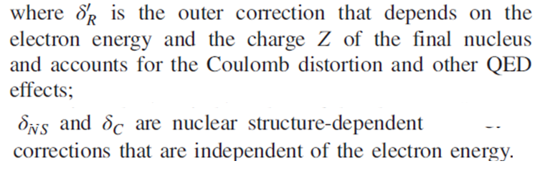
Superallowed 0⁺ → 0⁺ β transitions
The ft value of any β transition is simply the product of the phase-space factor f, and the partial half-life of the transition, t.
denotes the so-called inner or universal electroweak radiative corrections (nucleus-independent corrections)

Slide 4
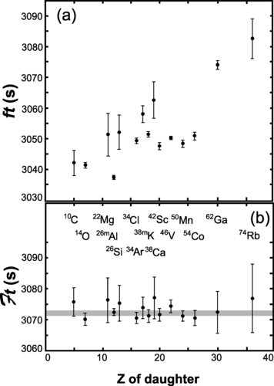

Superallowed 0⁺ → 0⁺ β transitions
(a) In the top panel are plotted the uncorrected experimental ft values for the 15 precisely known superallowed transitions as a function of the charge on the daughter nucleus.
(b) In the bottom panel, the corresponding values are given; they differ from the ft values by the inclusion of the correction terms δ′_{R}, δ_{NS}, and δ_{C}.
The horizontal gray band gives one standard deviation around the average value. All transitions are labeled by their parent nuclei.
J. C. Hardy and I. S. Towner
Phys. Rev. C 102, 045501 – Published 2 October 2020

Slide 5


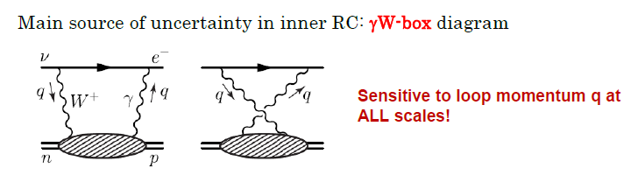

Superallowed 0⁺ → 0⁺ β transitions
Based on these 15 experimental data, Hardy and Towner recently updated the average
includes the charged current axial-vector box contribution, involving the exchange of W boson and photon between the leptons and hadrons (axial here refers to the coupling of the W to the hadron). This correction is not protected from the effects of the strong interaction, and has an associated hadronic uncertainty which needs to be accurately estimated.
A somewhat different approach
J. C. Hardy and I. S. Towner, Phys. Rev. C 102, 4, 045501 (2020).
C.-Y. Seng et al., Phys. Rev. Lett. 121, 24, 241804 (2018)
A. Czarnecki, W. J. Marciano and A. Sirlin, Phys. Rev. D 100, 7, 073008 (2019)
V_{ud} has shifted significantly down compared to the 2018 PDG value of V_{ud} = 0.97420(21)
PDG (2018)
Currently the 15 most precisely measured superallowed 0+→0+ nuclear beta decays transitions lead to the dispersion relation based weighted average of
V_{ud} = 0.97373(11)_{exp}., _{nucl.} (9)_{RC} (27)_{NS} 2021 PDG
P.A. Zyla et al. (Particle Data Group), Prog. Theor. Exp. Phys. 2020, 083C01 (2021) and 2021 update 1st December, 2021 8:58 am
Notes:
Радиационные поправки к β-распадам обычно относятся две категории: внешние поправки, которые включают зависящие от энергии члены (например, тормозное излучение), и внутренние поправки, которые можно вычислить с высокой точностью и обычно включаются в эффективные муфты. соответствующая внутренняя поправка ΔV_{R} включает зарядный ток вклад аксиально-векторного ящика, обозначаемый □γWА , с участием обмен W-бозоном и фотоном между лептоны и адроны (аксиальный здесь относится к связи W к адрону). Это исправление не защищено от эффектов сильного взаимодействия и имеет связанная с этим адронная неопределенность, которую необходимо точно оценить.

Slide 6
Superallowed 0⁺ → 0⁺ β transitions V_{ud}
2016 The most precise determination of |V_{ud}| comes from the study of superallowed 0+ → 0 + nuclear beta decays, which are pure vector transitions. Taking the average of the fourteen most precise determinations yields |V_{ud}| = 0.97417 ± 0.00021.
The error is dominated by theoretical uncertainties stemming from nuclear Coulomb distortions and radiative corrections.
2018 Current world data establish the corrected values of 14 separate superallowed transitions to a precision of order 0.1% or better. The validity of the small theoretical correction terms is confirmed by excellent consistency among the 14 values and by recent measurements that compare pairs of mirror superallowed transitions. With consistency established, the results now yield |V_{ud}| = 0.97420(21).
2020 |V_{ud}| = 0.97370 ± 0.00014
2021 PDG
Currently the 15 most precisely measured superallowed 0+→0+ nuclear beta decays transitions lead to the dispersion relation based weighted average of
V_{ud} = 0.97373(11)_{exp}., _{nucl.} (9)_{RC} (27)_{NS}
Notes:
2016

Slide 7




Neutron lifetime
Neutron β decay is the simplest β decay to involve both the vector and axial-vector weak interactions. It is an attractive option for determining V_{ud} since its analysis does not require the application of corrections for isospin-symmetry-breaking δ_{C}, or for nuclear-structure-dependent radiative effects, δ_{NS}.
However, it has the distinct disadvantage that it requires a difficult correlation measurement in order to separate the vector-current contribution to its decay from the axial-vector one.
Measurements of the neutron lifetime, τ_{n}, and the ratio of axial-vector/vector couplings, g_{A} ≡ G_{A}/G_{V} , via neutron decay asymmetries combined with the inner radiative corrections can also be used to determine V_{ud} via the precise formula:
represents the same inner electroweak radiative corrections
superallowed 0+→0+ V_{ud} = 0.97373(11)_{exp}., _{nucl.} (9)_{RC} (27)_{NS}

Slide 8
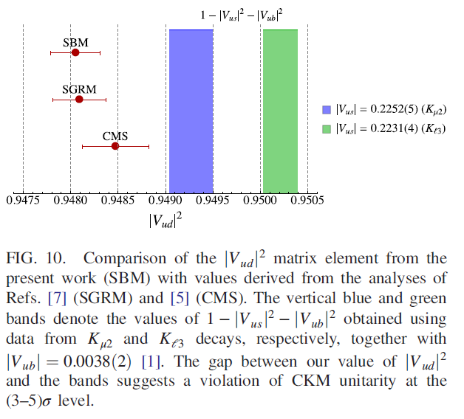
Standard Model
Superallowed 0⁺ → 0⁺ β transitions
where the first error is the uncertainty from |V_{ud}|² and the second error is the uncertainty from the average |V_{us}|²
One finds about an overall 2 sigma deviation from unitarity. That deviation could be due a problem with |V_{ud}| theory (RC or NS), the lattice determination of f+(0) or new physics.
PHYSICAL REVIEW D 104, 033003 (2021)

Slide 9
Neutron lifetime and
Primordial Helium Abundance

Slide 10
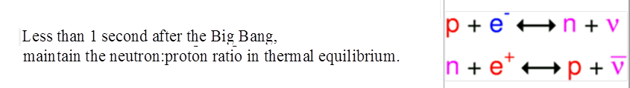
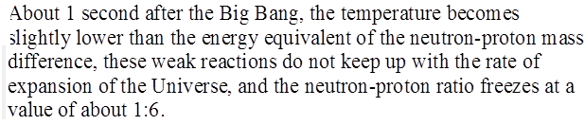
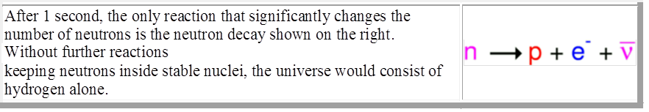
Nucleosynthesis

Slide 11
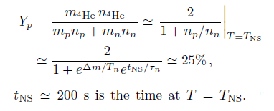
Nucleosynthesis
After the neutron freeze-out, proton number does not change while neutrons can decay
with a lifetime n.
As the temperature further cools, protons and the remaining neutrons bind into deuterium via the reaction
Nucleosynthesis starts with the formation of deuterium and helium-4 at T_{NS} ≈ 100 keV

Slide 12
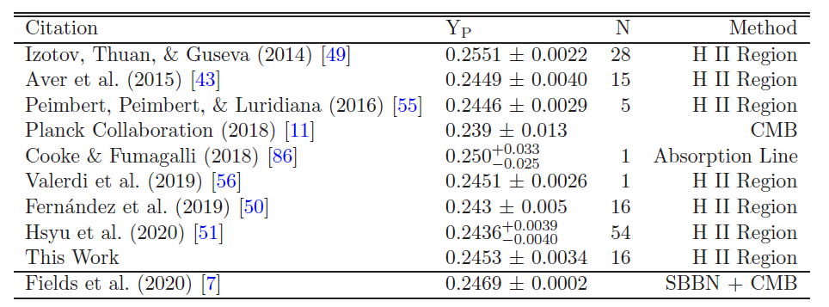
Recent Primordial Helium Abundance
Results from low metallicity galaxies
In astronomy, metallicity is the abundance of elements present in an object that are heavier than hydrogen and helium.
extremely metal-poor galaxies (EMPGs)
cosmic microwave background (CMB)
Big Bang Nucleosynthsis (BBN)
arXiv:2010.04180 [astro-ph.CO]

Slide 13
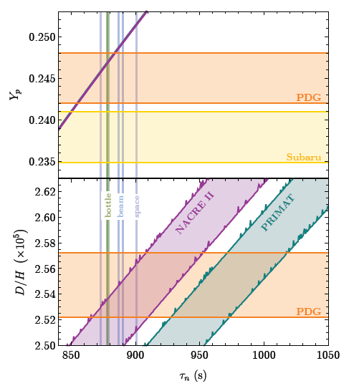
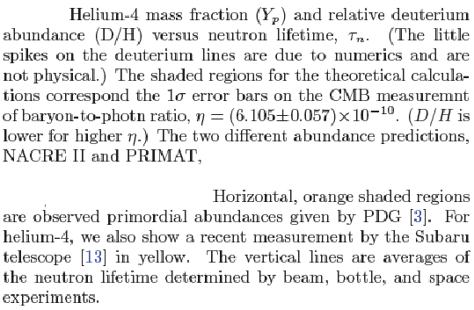


Recent Primordial Helium Abundance
One approach is employed by NACRE II [1] and
used in many BBN analyses, e.g. in [28]. Another ap-
proach is to use theoretical calculations as an input for
this temperature dependence. This is used in the BBN
program PRIMAT
arXiv:2210.12031v1 [hep-ph] 21 Oct 2022
A. Matsumoto et al., (2022), arXiv:2203.09617 [astro-ph.CO].

Slide 14
Neutron lifetime experiments

Slide 15
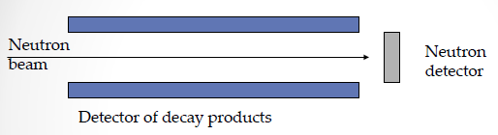
Beam measurements of neutron lifetime
Accurate measurements of absolute value of
neutron flux and collection of decay products
Unregistered decay products will increase neutron lifetime
2. UCN storage measurement of neutron lifetime – relative measurement
Storage losses will decrease neutron lifetime
Material traps
Magnetic traps
Collisions with the walls - losses
Neutron depolarization – losses
But these losses can be measured
Notes:
Material traps Neutron depolarization - losses
Magnetic traps

Slide 16
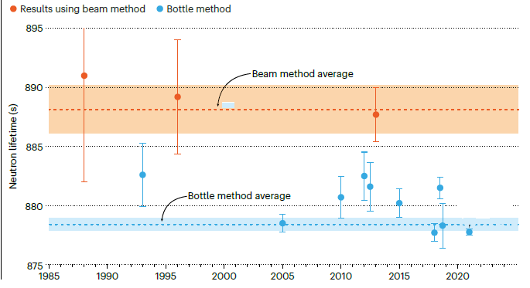

Slide 17
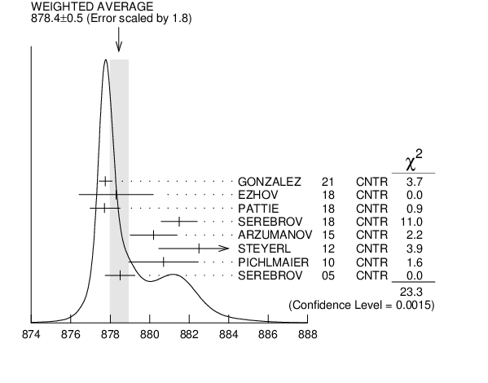
Neutron lifetime PDG
τ = 887,7 ± 1,2 ± 1,9 s – isn’t included
We average seven of the best eight measurements, those made with ultracold neutrons (UCN's). If we include the one in-beam measurement with a comparable error (YUE 2013 ), we get 879.6 ±0.8 s, where the scale factor is now 2.0.

Slide 18
Possible dark decay channels
Exotic decays that are completely dark, or with the dark fermion accompanied either by visible particles such as γ or e+e– , or by invisible pairs or dark photons.
The disappearance of neutrons via neutron mirror-neutron oscillations and the role of neutron-antineutron oscillations in dark neutron decay.
Fierz term of size b = 1.44% would enhance the branching ratio of dark decays, allowed by existing neutron data, to the level required to explain the neutron lifetime anomaly. This in turn, however, leads to some tension with the experimental limit on b from.

Slide 19
The main problem of UCN storage experiments – possible losses during storage time

Slide 20
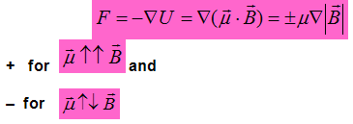
Magnetic trapping permits to exclude UCN collisions with a wall
Magnetic trap
  Reflection of UCN by magnetic barrier
  V.V. Vladimirskii, Sov. Phys. - JETP 12, 740, 1961
Magnetic field 1 T reflects neutrons up to 3.4 m/s
Notes:
Magnetic trap

Slide 21
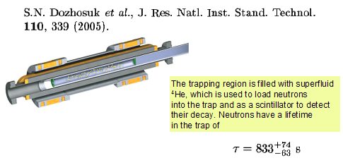

Neutron magnetic storage - (mile stones)
Magnetic mirrors, channels and bottles neutrons.
Vladimirskii V.V., Sov. Phys. JETP 12, 740-746, (1961) (ITEP)
Current systems
Kosvintsev Yu.Yu., Kushnir Yu.A., Morozov V.I., Plotnikov I.A.
JETP Letters v. 27(1), 65, (1978) (SRIAR)
=35±10 sec
Abov Yu.G., Vasil’ev V.V., Vladimirskii V.V., Rozhnin I.B., JETP Letters v. 44(8), 472, (1986). (ITEP)
τ > 700 sec
Superconducting
W. Paul, F. Anton, L. Paul, S. Paul, and W. Mampe,
Z. f. Physik C 45, 25 (1989). (ILL + Munich)
τ= 877 ± 10 s
S.N. Dozbosuk et. al., J. Res. Natl. Inst. Stand. Technol. 110, 339, (2005) (Los-Alamos)
Permanent magnets
V.F. Ezhov et. al., arXiv:1412.7434 [nucl-ex], (2014) (PNPI + ILL)
$$τ_{n}=878.2±1.9 s$$
Notes:
Магнитные зеркала, каналы и бутылки для холодных нейтронов
В.В. Владимирский ЖЕТФ т.39(4), 1062, 1960
Хранение УХН в сосуде с магнитной стенкой
Ю.Ю. Косвинцев, Ю.А. Кушнир, В.И. Морозов
Письма ЖЭТФ, т. 23(2), 135, (1976)
Токовые системы
Сверрхпроводящие
Постоянные магниты
S.N. Dozbosuk et. al., J. Res. Natl. Inst. Stand. Technol. 110, 339, (2005)

Slide 22
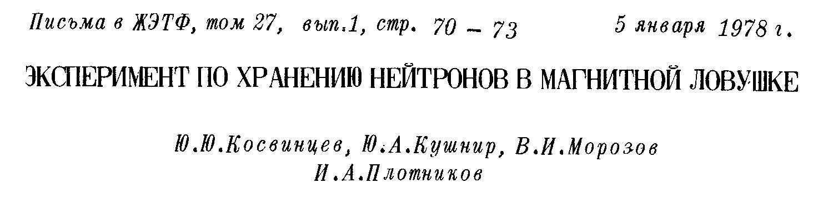
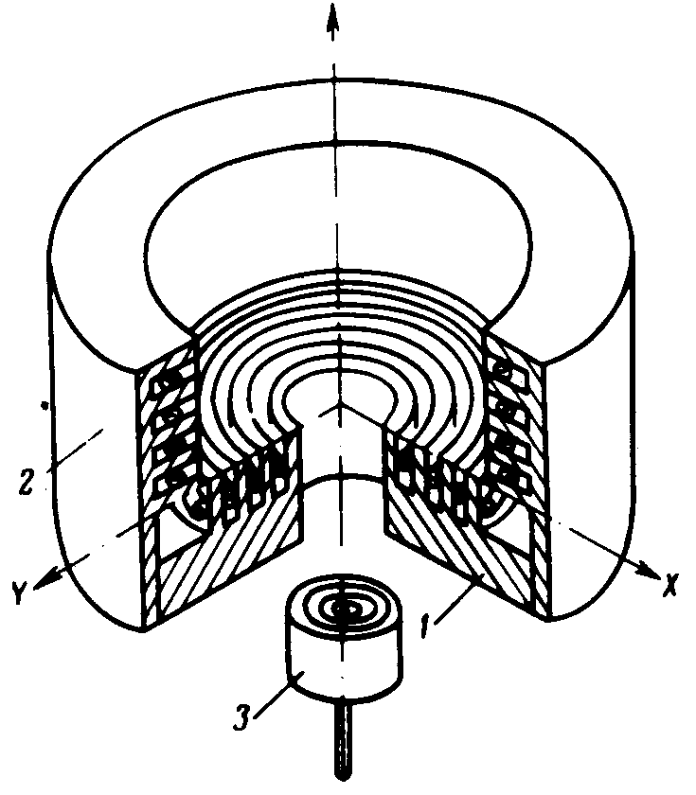
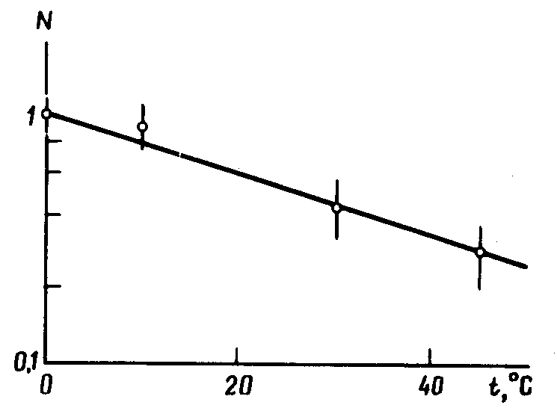
Trap Filling
Kosvintsev Yu.Yu., Kushnir Yu.A., Morozov V.I., Plotnikov I.A. Experiment on neutron storage in a magnetic trap, v. 27(1), p. 65, (1978)
First real magnetic trap
Reactor CM-2
W=20 kW
=35 s
Notes:
W=20 kW
Reactor CM-2
First real magnetic trap
Kosvintsev Yu.Yu., Kushnir Yu.A., Morozov V.I., Plotnikov I.A. Experiment on neutron storage in a magnetictrap

Slide 23
Trap Filling
Ioffe-Pritchard trap
for neutrons
The main problems:
Filling and empting. If one use superconducting system, then he can’t switch on field too fast.
Huge setup and small storage volume
Field only 1 T
Notes:
=87710 s

Slide 24
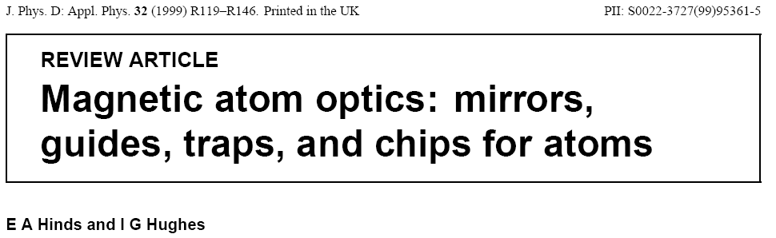
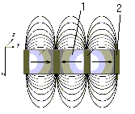
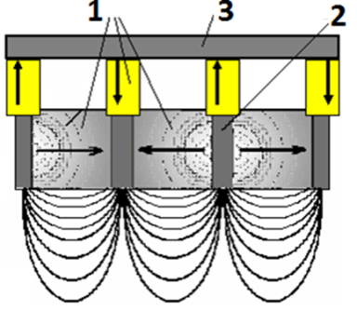
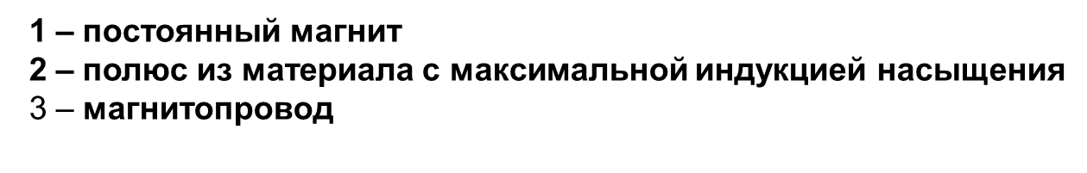
Magnetic wall of
Permanent magnets?
Notes:
Permanent magnets

Slide 25
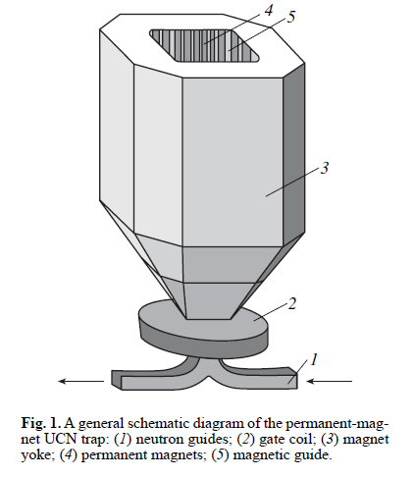
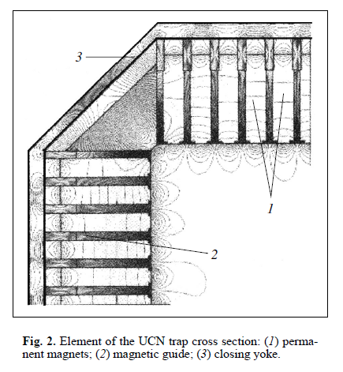
Magnetic trap made of permanent magnets - the first suggestion
V. F. Ezhov, B. A. Bazarov, P. Geltenbort N. A. Kovrizhnykh, G. B. Krygin, V. L. Ryabov, and A. P. Serebrov
Permanent-Magnet Trap for Ultracold Neutron Storage
Technical Physics Letters, Vol. 27, No. 12, 2001, pp. 1055–1057.
Magnetic shutter
Notes:
Magnetic trap made of permanent magnets - the first suggestion

Slide 26


Depolarization
Adiabatic condition
Magnetic field in trap is too inhomogeneous
Main task to exclude zero points of magnetic fields
The magnetic moment precession frequency around the driving field should be much greater than the rotation frequency of the magnetic field (in neutron reference) due to neutron moving in a non uniform magnetic field
Notes:
The magnetic moment precession frequency around the driving field should be much greater than the frequency of rotation of the magnetic field due to neutron moving in a non uniform magnetic field

Slide 27
It is impossible to exclude UCN depolarization
If anybody satisfies adiabatic condition with accuracy, for example, 10⁻⁶ it’ll mean that 1 UCN from 10⁶ will be depolarized!!!
So one have to measure losses due to depolarization in his experiment with magnetic storage
Main advantage of magnetic trapping in comparing with UCN storage in material trap is the possibility to detect UCN losses during storage time

Slide 28
Today there are two types of UCN magnetic traps used in neutron lifetime experiments
  Mechanical shutter
  Magnetic shutter

Slide 29
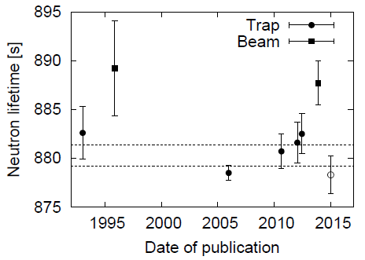
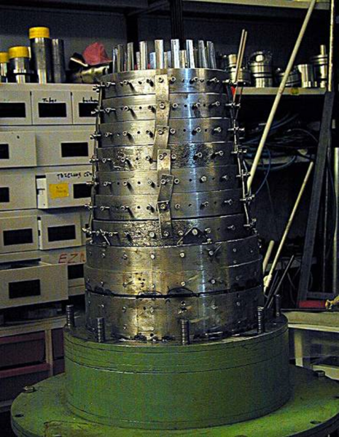
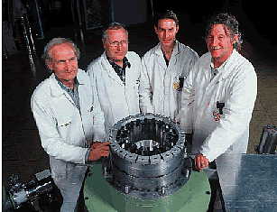
UCN magnetic storage and neutron lifetime PNPI-ILL
Step by step
2014
First trap of permanent magnets
2003
882 ± 16 s.
_{n}=(878.3±1.9) s.
(Submitted on 23 Dec 2014)
arXiv:1412.7434 [nucl-ex]
_{n} = (878.3 ± 1.6 ± 1.0) s
V.F. Ezhov et. al. JETP Letters, 2018, Vol. 107, No. 11, pp. 671–675
Notes:
Waited accuracy 0.2 s

Slide 30
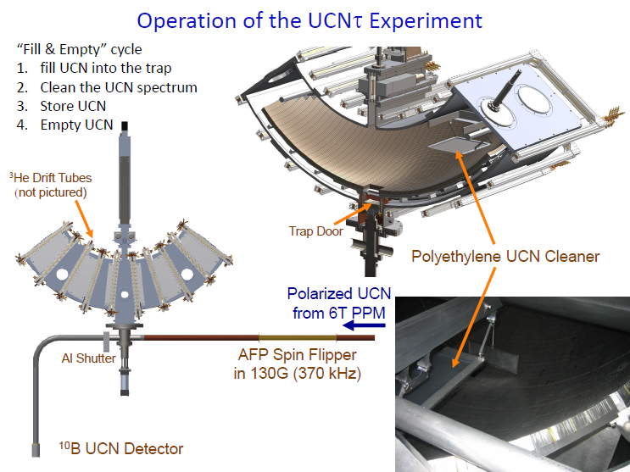
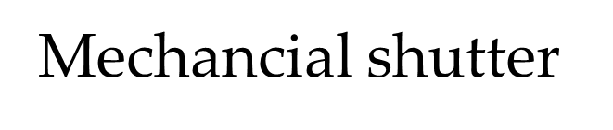
R. Pattie et al., Measurement of the neutron lifetime using a magneto-gravitational trap, Science 10.1126/science.aan8895 , 2018.

Slide 31
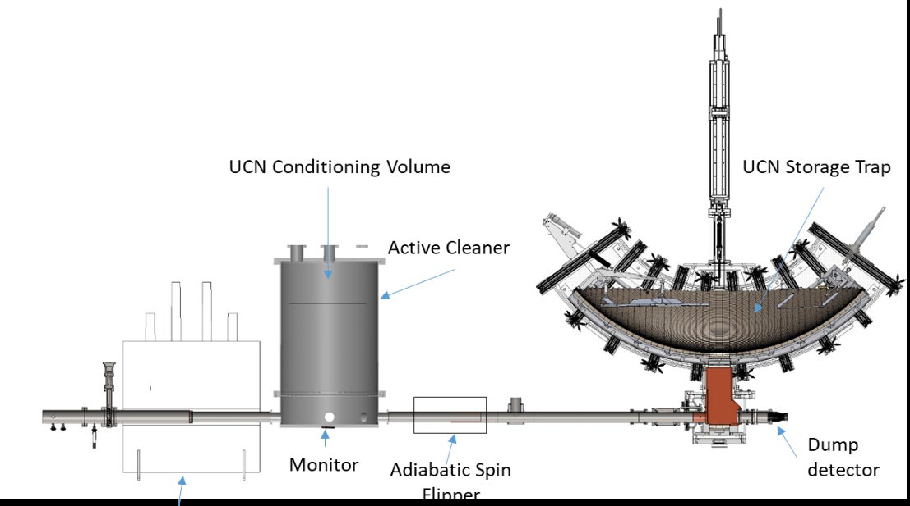
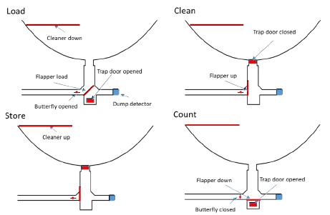

Slide 32
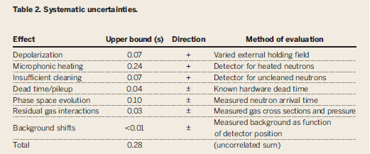
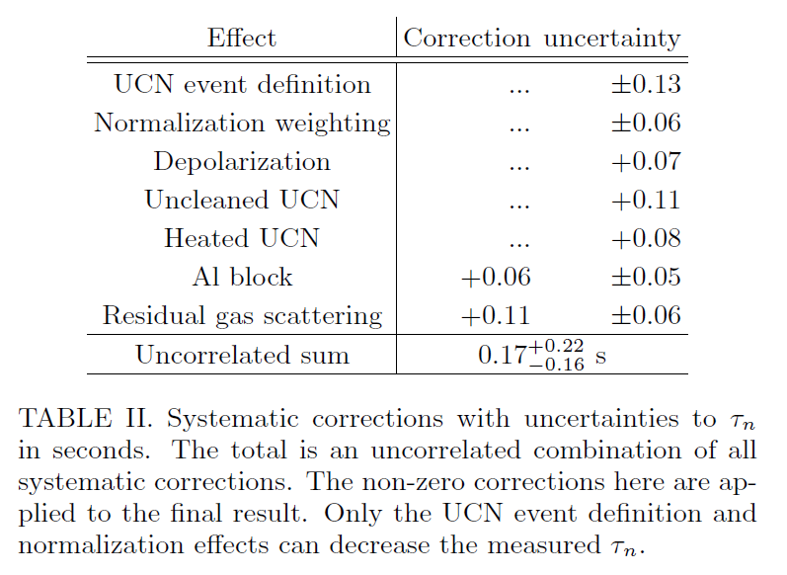

Slide 33
Main properties of “ideal” experimental setup for neutron lifetime measuring
On-line control of UCN losses
Measuring of efficiency of UCN losses detection
Result have to be independent from transformation of neutrons spectra during storage. (Small UCN heating?)
  Fluctuation of magnetic field (thermal and vibration)
Control of UCN spectra cleaning
Monitoring of filling directly in trap. (for an example, mechanical filling shutter can have slightly different position in each cycle)
Storage time independence of vacuum
It’s necessary to have minimum three point of different storage time at decay curve.
1 – 5 problems can be solved using magnetic shutter

Slide 34
Magnetic shutter – main characteristics
Magnetic shutter is transparent for depolarized neutrons and neutrons that energy exceeds the energy of shutter magnetic barrier, so it permits to control UCN losses during storage time as connected with depolarization, so with small UCN heating
Shutter magnetic barrier has to be less then magnetic barrier of the wall
Filling trap with unpolarized UCN gives monitor for each filling cycle
Artificial depolarization permits to measure efficiency of depolarized neutron collection

Slide 35
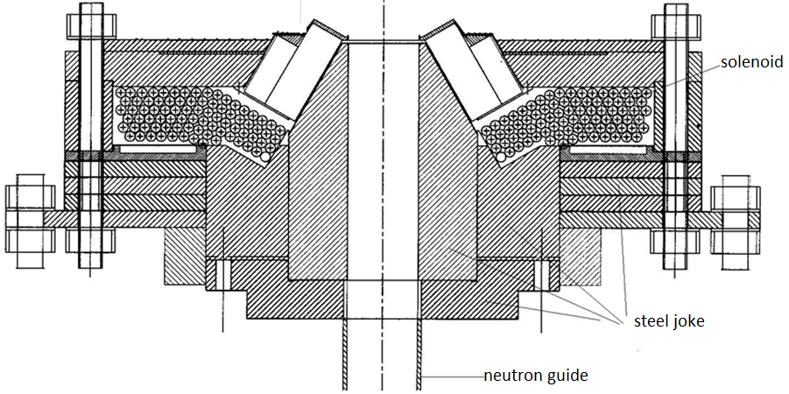
PNPI magnetic shutter – main idea
V.F. Ezhov, et al, Technical Physics Letters, Vol. 44, No. 7, pp. 602–604, 2018.
Permanent magnets
Notes:
y

Slide 36
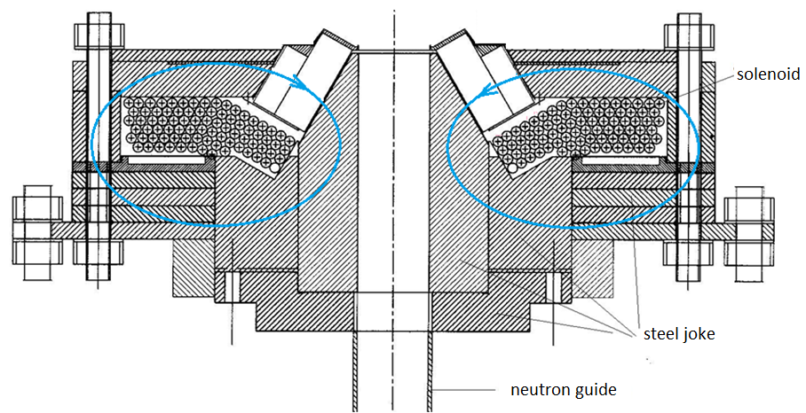
PNPI magnetic shutter – main idea
Permanent magnets
Permanent magnets
Notes:
Permanent magnets

Slide 37
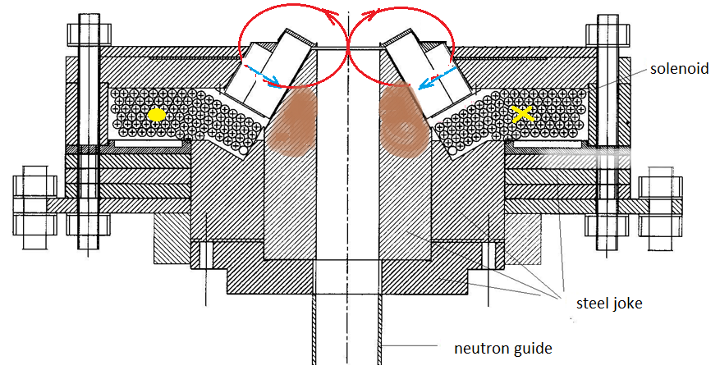
PNPI magnetic shutter – main idea
Permanent magnets

Slide 38
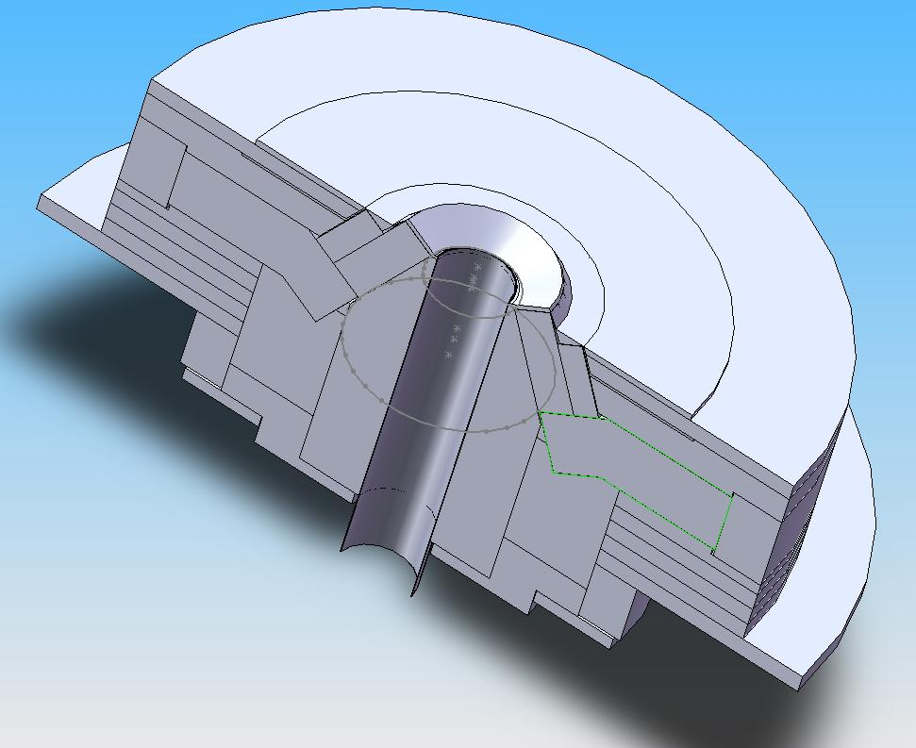
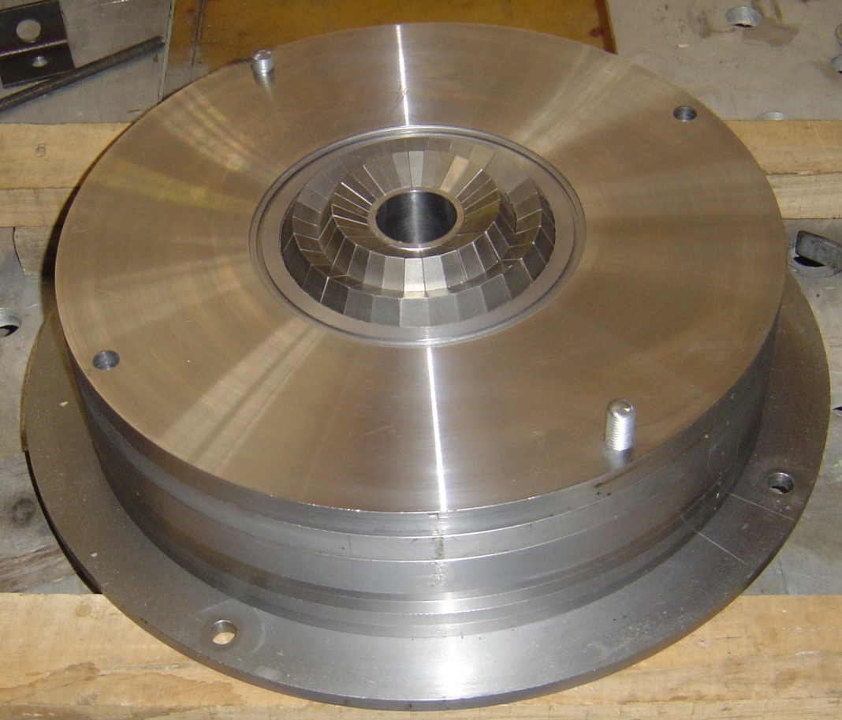
Magnetic shutter

Slide 39
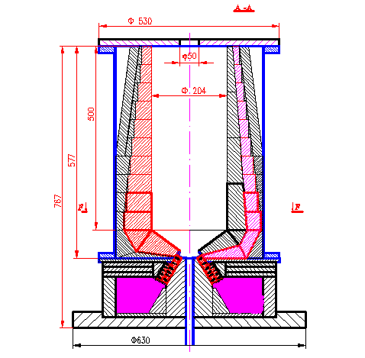
Filling through lower neutron guide
Neutrons heating at the moment of magnetic shutter switching on

Slide 40
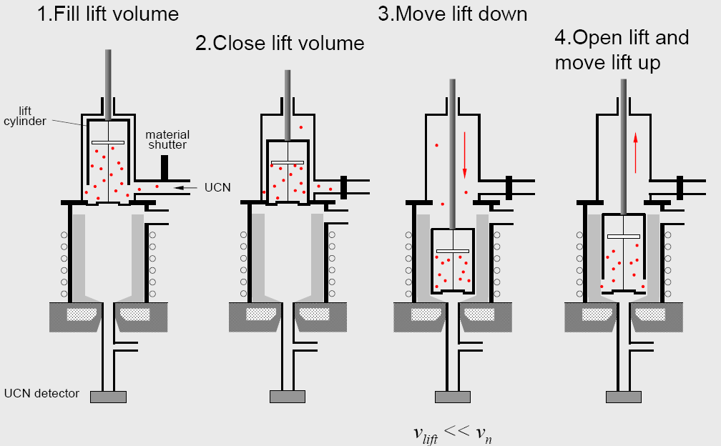
Monitor of trap filling
Trap is filling with unpolarized UCN. In this case half of UCN will be detected just during the filling

Slide 41
Control of the depolarized (or spin flipped) UCN
To control the spin flipped UCN the inner trap walls are covered with thin layer of fomblin that barrier is higher than magnetic one and reflects spin flipped UCN. After some collisions (order of 10-th) the spin flipped UCNs penetrate through the magnetic barrier of solenoid and are detected by the UCN detector installed below the solenoid. Hence this intensity may be used as the detector of UCN losses during storage time.

Slide 42
Transformation of neutrons spectra during storage
Small UCN heating?
To exclude this effect the magnetic barrier in magnetic shutter have to be less then magnetic barrier of the wall. So in case of small heating during storage such neutrons will be reflected by barrier of the wall and leave the trap through magnetic shutter and fall down to detector. As a result they will be taken into account as losses in trap. They will be equal to depolarized neutrons.
Uncleaned UCN
(Wall magnetic barrier higher then shutter one) – it means that uncleaning UCN – will be registered by detector during storage time as losses too.

Slide 43
Control of the depolarized (or spin flipped) UCN
To control the spin flipped UCN the inner trap walls are covered with thin layer of fomblin that barrier is higher than magnetic one and reflects spin flipped UCN. After some collisions (order of 10-th) the spin flipped UCNs penetrate through the magnetic barrier of solenoid and are detected by the UCN detector installed below the solenoid. Hence this intensity may be used as the detector of UCN losses during storage time.

Slide 44
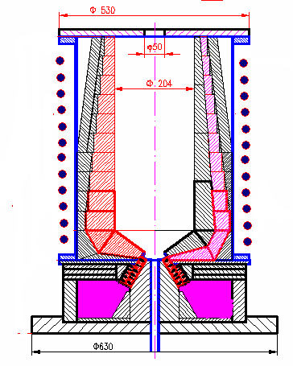
Efficiency of spin flipped neutron collection
(direct measuring using artificial depolarization)
Artificial depolarization is switch on by changing current in
outer solenoid (it used to exclude zero points of magnetic field)
Outer solenoid
Notes:
Efficiency of spinflipped neutron collection
Outer solenoid

Slide 45


Vacuum dependence (rest gases)
${\text{}}_{p}$p$≪_{decay}$
p < ${10}^{−7 }$torr for 0.2 s accuracy

Slide 46
Fomblin vapor scattering?
Calibration
Fomblin spectrum under 98 C
Spectrum of the rest vapor
in the trap that wall covered with fomblin
Notes:
Fomblin spectrum under 98 C

Slide 47
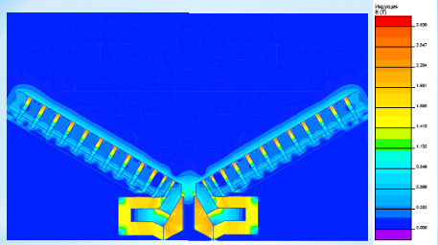
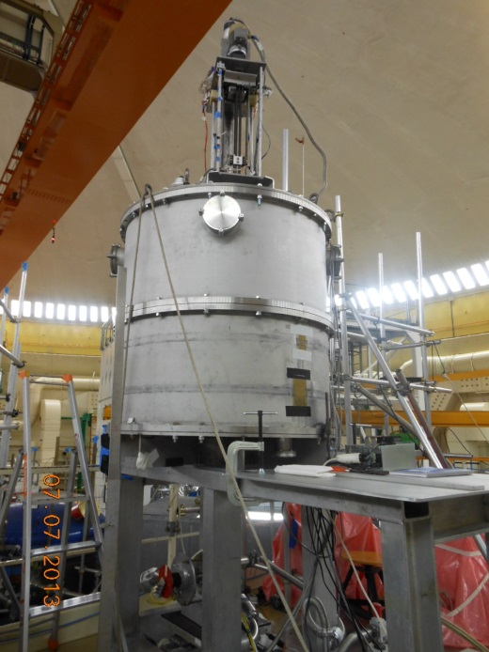
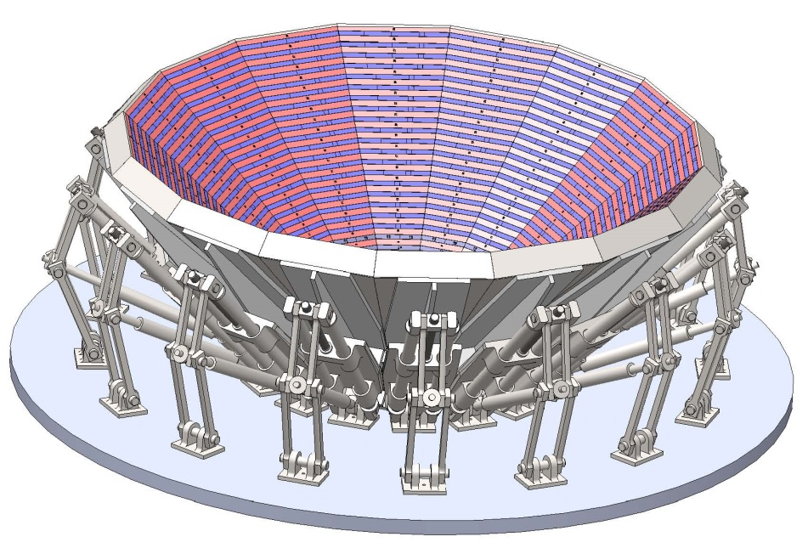
New trap under construction
B. A. Bazarov et al, Technical Physics Letters 42(7), 663-666, (2016)
Increasing of volume is about 15 times
Increasing of stored UCN energy in 2 times due to increasing shutter magnetic barrier value
Waited accuracy about 0.2 s.
Calculated map of magnetic field
for a new trap
Vacuum chamber and filling system for new trap (ILL, Level D)
Notes:
System for new trap filling in ILL

Slide 48
Thank you for attention

Slide 50
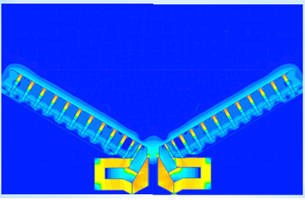
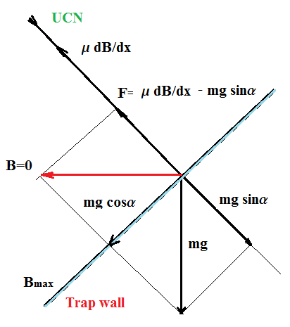

UCN reflections by magnetic barrier and mirror trajectories
t
UCN flow
Notes:
UCN flow
UCN reflections by magnetic barrier

Slide 51


Slide 52


Chien-Yeah Seng, Mikhail Gorchtein, and Michael J. Ramsey-Musolf
PHYSICAL REVIEW D 100, 013001 (2019)

Slide 53




Superallowed 0+→ 0 + β decay between T = 1 analog states depends uniquely on the vector part of the weak interaction and, according to the conserved vector current (CVC) hypothesis, its experimental ft value should be directly related to the vector coupling constant, a fundamental constant which is the same for all such transitions. In practice, the expression for ft includes several small (∼1%) correction terms. It is convenient to combine some of these terms with the ft value and define a “corrected” value.
G_{V} is the vector coupling constant for semi-leptonic weak interactions, is the isospin symmetry-breaking correction and is the transition independent part of the radiative correction. The terms comprise the transition-dependent part of the radiative correction, the former being a function only of the electron’s energy and the Z of the daughter nucleus, while the latter, like depends in its evaluation on the details of nuclear structure. From this equation, it can be seen that each measured transition establishes an individual value for G_{V} and, if the CVC assertion is correct that G_{V} is not renormalized in the nuclear medium, all such values – and all the values themselves – should be identical within uncertainties, regardless of the specific nuclei involved.

Slide 54


Slide 55


The Neutron Lifetime and Axial Coupling Connection
In the SM, the inverse lifetime equation relating _{n} and ɡ_{A}
RC represents electroweak radiative corrections +0.03886(38)
f is a phase space factor f = 1.6887(1)
_{From these input parameters}
_{This formula permits to find} Vud, from independent experimental measurements of _{n} and ɡ_{A. Main aim} _{to reach ±0.01% sensitivity} _{for input parameters.}
One can use this formula to correlate _{n} and ɡ_{A instead of} Vud measuring. To that end, we employ the super-allowed 0+0+ nuclear transitions current best value from SM
V_{ud =} 0.97420(10)_{nucl and exp}(18)RC where the errors are due to nuclear and experimental uncertainties and electroweak radiative corrections (RC), respectively.
A. Czarnecki, W. J. Marciano and A. Sirlin, Neutron lifetime and axial coupling connection, Phys. Rev. Lett. 120, 202002, 2018.

Slide 56


Trap Filling
=87710 s

Slide 57

Improved Determination of the Neutron Lifetime
Phys. Rev. Lett. 111, 222501 – Published 27 November 2013
A. T. Yue, M. S. Dewey, D. M. Gilliam, G. L. Greene, A. B. Laptev, J. S. Nico, W. M. Snow, and F. E. Wietfeldt
τ = 887,7 ± 1,2 ± 1,9 с

Slide 58


V.F. Ezhov et. al. JETP Letters, 2018, Vol. 107, No. 11, pp. 671–675
Magnetic shutter in lower part of trap
permits to collect depolarized UCN during
storage time.
_{n} = (878.3 ± 1.6 ± 1.0) s
Trap is filled using elevator in upper part of trap. There are an absorber inside elevator for preliminary preparation of UCN spectrum. Final cleaning proceeds inside the trap throw magnetic shutter in lower part of trap
V.F. Ezhov, et al, Technical Physics Letters, Vol. 44, No. 7, pp. 602–604, 2018.

