Slide 1
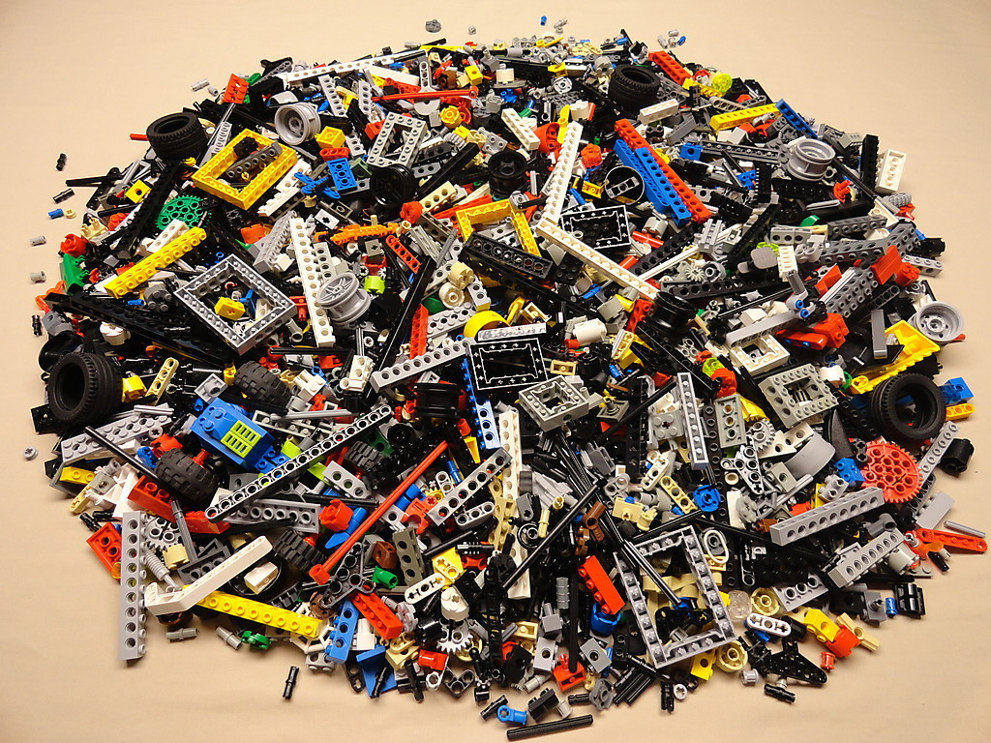

Slide 2
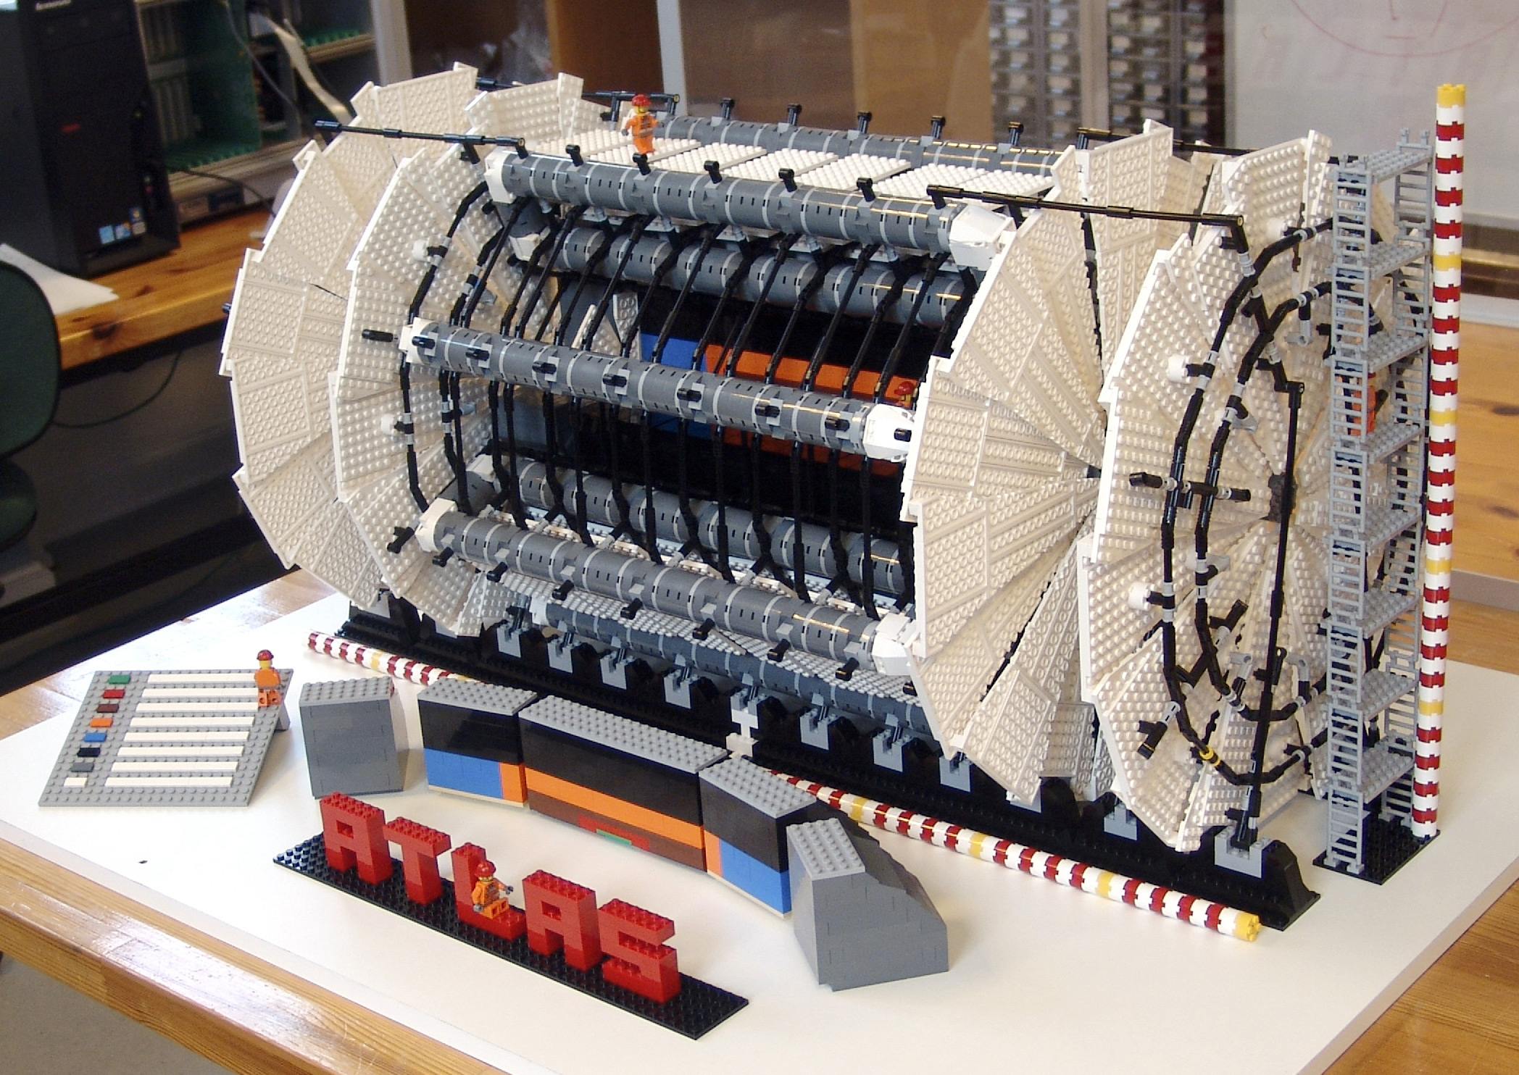
ATLAS эксперимент
Научная сессия ученого совета ОФВЭ ПИЯФ
24-27 декабря 2012 года
Олег Федин
Notes:
ё

Slide 3
Содержание
Status of the ATLAS detector.
Performance of the ATLAS detector:
  to highlight the PNPI’s participation for the further improvement and control of the ATLAS performance.
PNPI participation in ATLAS:
  physics program;
  detector development;
  TDAQ/DCS.
PNPI plans for ATLAS upgrade.

Slide 4
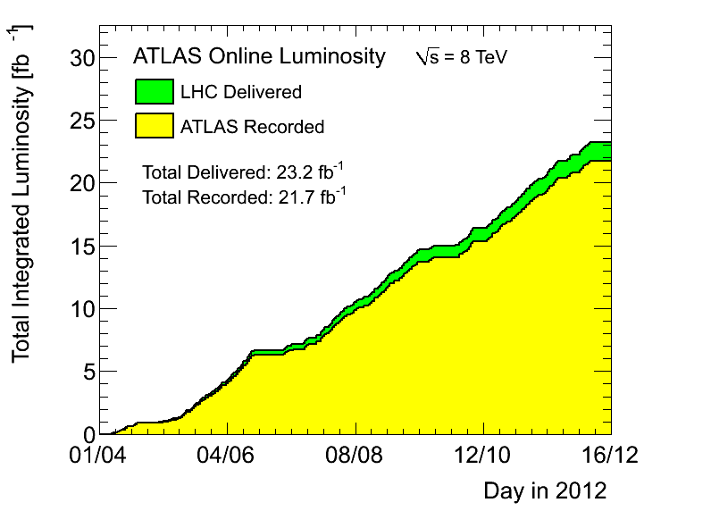
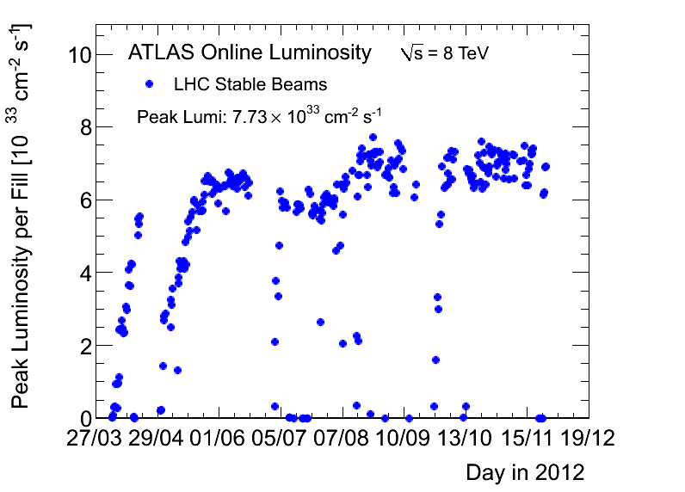
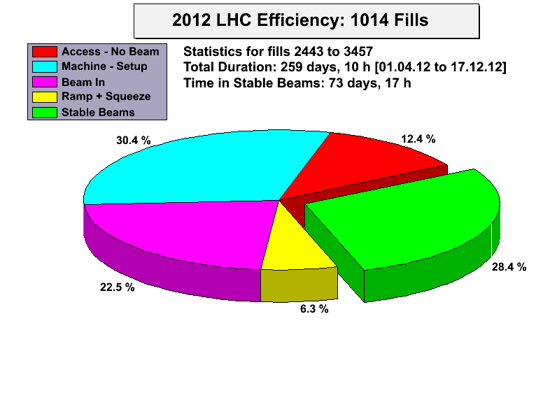
p-p integrated luminosity vs time
Total integrated luminosity in 2012
Peak luminosity seen by ATLAS: ~ 7.73 x10³³ cm⁻² s⁻¹
Number of events in full 2010-2012 dataset (~ 25 fb⁻¹) after all selection cuts:
W → lν ~ 100 M (LEP2: 0.2M pair W⁺/W⁻)
Z→ ll ~ 10 M (LEP 16M )
tt → l+X ~ 0.4 M
SM Higgs ~ 400
[~1 H→ γγ (~1 H→ 4l) produced every 50’ (14h)
at 7x 10³³ ]
ICHEP,4 of July ~ 5 fb⁻¹
Higgs discovery
Time in stable beam 73 days out of 259 days of LHC works (28.4%) (2011 23.5%)
LHC records in 2012 (in brackets results for 2011)
Maximum luminosity delivered in one fill 237.32 pb⁻¹ ⁽122.44)
Maximum luminosity delivered in one day 286.33 pb⁻¹ (135.45)
Maximum colliding bunches (design 2808) 1380 (1854)
Maximum bunch population (design 1.15 10¹¹) ~2.0 10¹¹ (1. 10¹¹)
Bunch spacing (design 25 ns) 50 ns
Maximum peak events per bunch crossing 71.55 (33.96)
Longest time in stable beam foe one fill 22.8 hours (26)

Slide 5
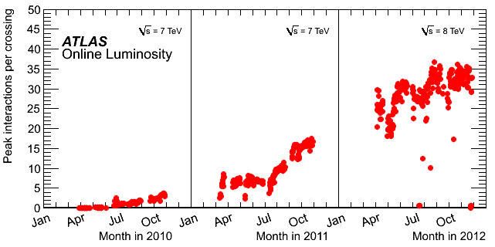
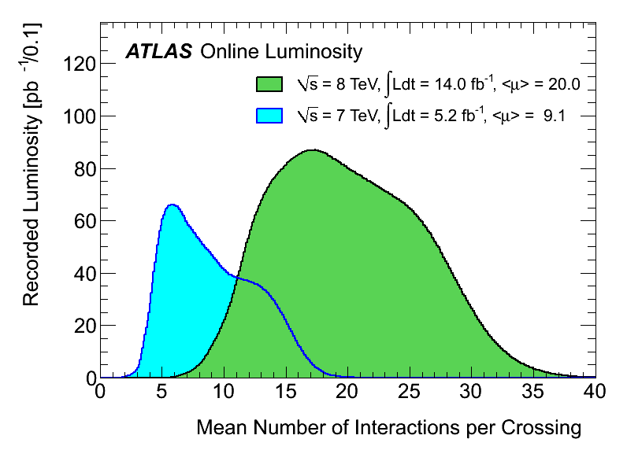
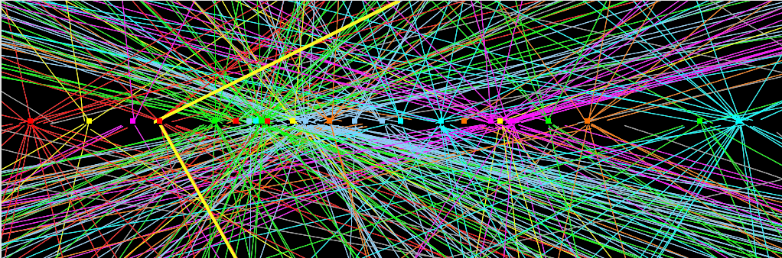
Multiple pp-collisions per bunch crossing
The BIG challenge in 2012: PILE-UP
Peak interaction per bunch crossing
Mean # of interaction per crossing
Experiment’s
design value
(expected to be
reached at L=10³⁴ !)
2011: <μ>=9
2012: <μ>=20
Z→μμ from 2012 data with 25 reconstructed vertex
(only tracks with pT>20 GeV and #Si hits >9 shown)
Z→μμ

Slide 6
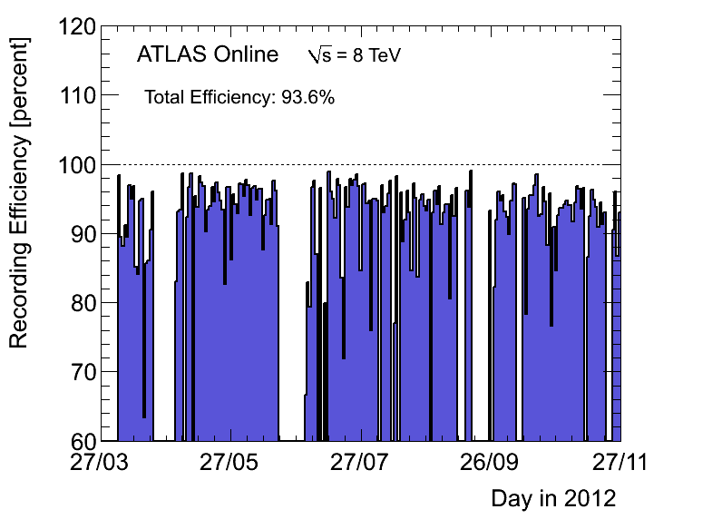
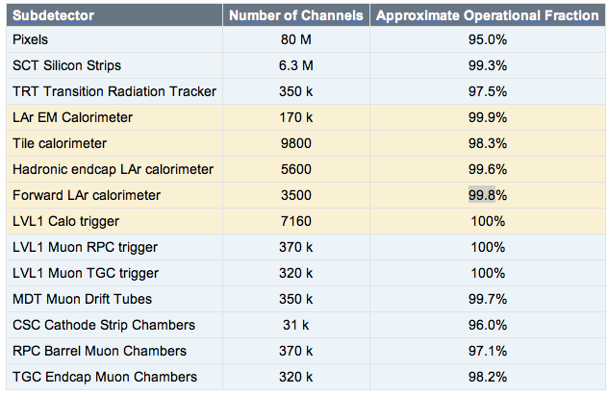
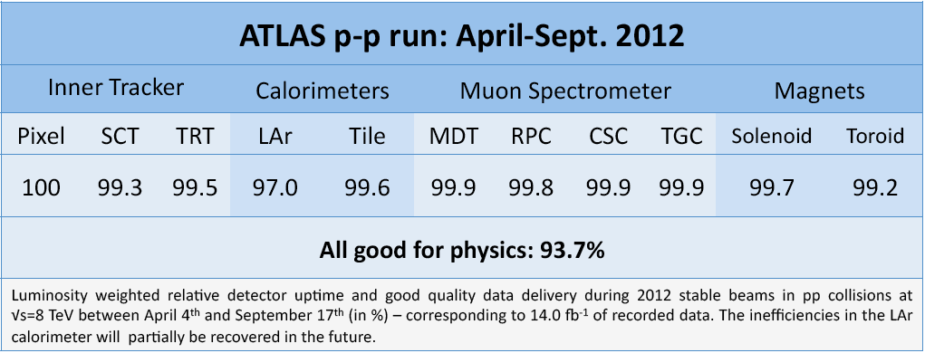
Detectors operation
Data-taking efficiency = (recorded lumi)/(delivered lumi): 93.7% (2011 -93.5%)
Fraction of non-operational detector channels:
(depends on the sub-detector) few permil to 3.5%
TRT
97.5%
93.7%
Good-quality data fraction, used for analysis : (depends on the analysis) : 90-96%

Slide 7
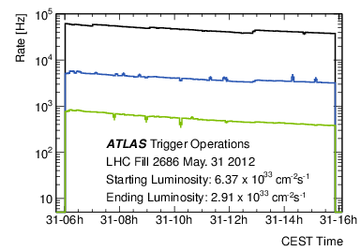
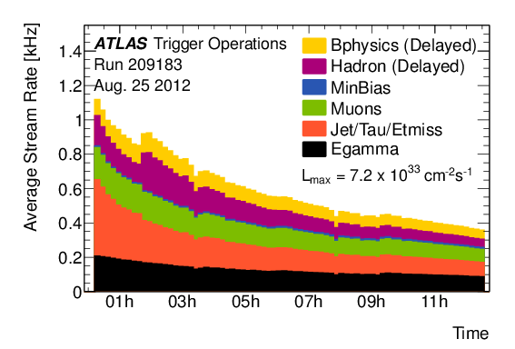
Trigger operation
Managed to keep inclusive un-prescaled lepton thresholds within ~ 5 GeV over last two years in spite of the factor ~70 peak luminosity increase
Lowest un-prescaled thresholds
(examples)
Item | p_{T} threshold (GeV) | Rate (Hz) at 5x10³³
Incl. e | 25 | 70
Incl. µ | 24 | 45
ee | 12 | 8
µµ | 13 | 5
ττ | 29,20 | 12
γγ | 35,25 | 10
E_{T}^{miss} | 80 | 17
L1: up to ~ 65 kHz
L2: up to ~ 5 kHz
EF: ~ 400Hz
Note > 550 items in trigger menu
Optimization of selections (e.g. object isolation) to maintain low un-prescaled thresholds (e.g. for inclusive leptons) in spite of x2 higher luminosity and pile-up than in 2011
Pile-up robust algorithms developed (~flat performance vs pile-up, minimize CPU usage, ...)
Results from 2012 operation show trigger is coping very well (in terms of rates, efficiencies, robustness, ..) with harsh conditions while meeting physics requirements

Slide 8
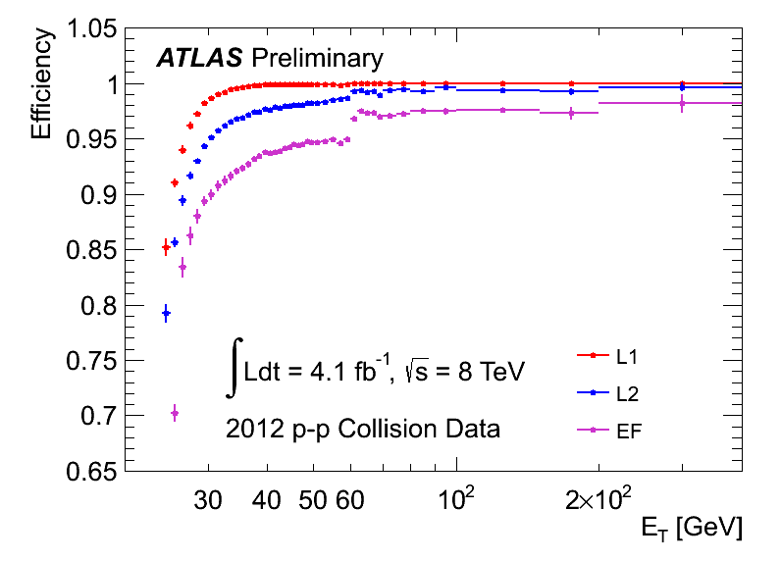
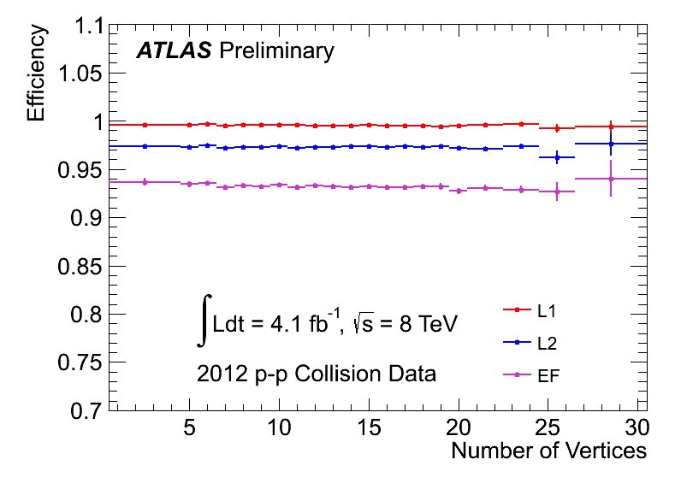
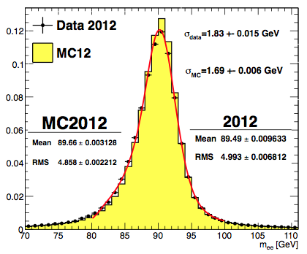
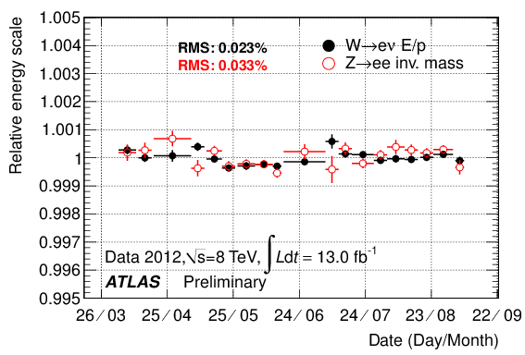
Electrons
Efficiency of inclusive electron trigger as a function of E_{T}
From Z→ ee events
Efficiency of inclusive electron trigger (E_{T} thresholds as low as 24) as a function of “pile-up”
e24vhi_medium1 OR e60_medium1
Stability of EM calorimeter response vs time
(and pile-up) during full 2012 run better than 0.1%
2012 Z→ee mass peak
Present understanding of calorimeter E response
(from Z, J/ψ → ee, W→ eν
data and MC):
E-scale at m_{Z} known to ~ 0.3%
Linearity better than 1% (few-100 GeV)
“Uniformity” (constant term of resolution): ~ 1% (2.5% for 1.37<|η|<1.8)
Mas resolution ~ 1.83 GeV (2%)

Slide 9
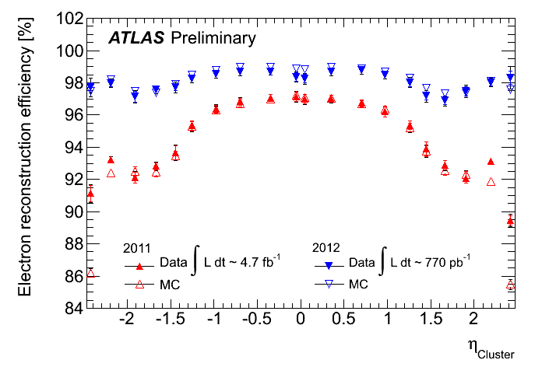
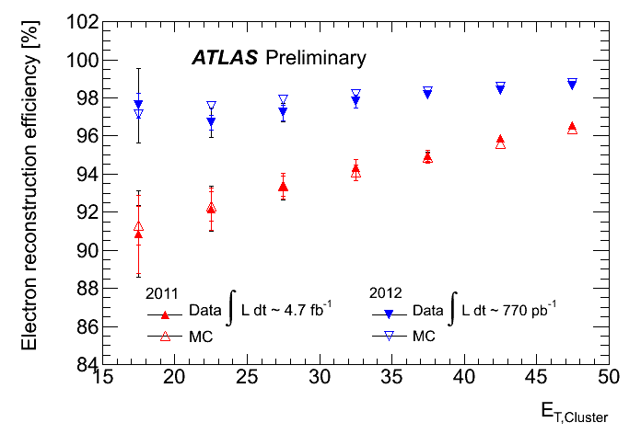
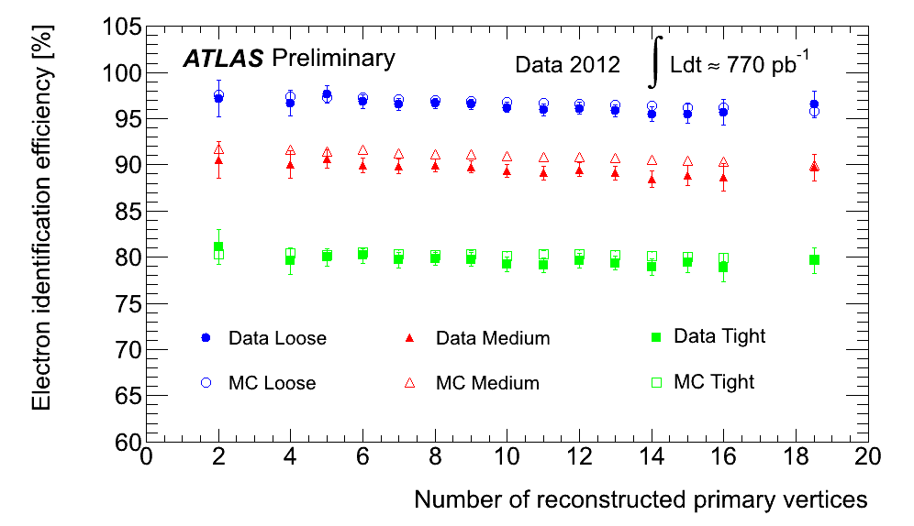
Electrons
High efficiency for low-p_{T} electrons (affected by material) crucial for H→ 4e, 2μ2e
Improved track reconstruction and fitting to recover e± undergoing hard Brem→ achieved ~ 98% reconstruction efficiency, flatter vs η and E_{T}
Reconstruction efficiency vs η
Reconstruction efficiency vs E_{T}
<ε>~98%
PNPI contribution:
software development for the tracks refit to account lost of the energy due to brem
validation of electron reconstruction and identification software
Re-optimized e± identification using
pile-up robust variables (e.g. Transition
Radiation, calorimeter strips) → achieved
~ 95% identification efficiency, ~ flat
vs pile-up; higher rejections of fakes
Results are from Z→ ee data and MC
tag-and-probe

Slide 10
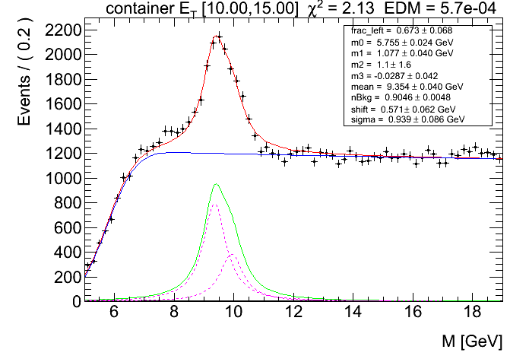
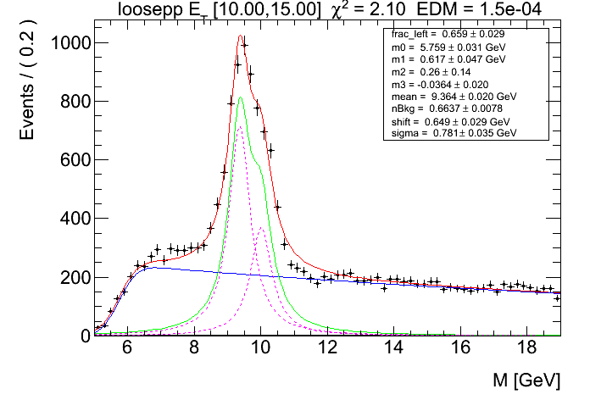
Electrons
PNPI contribution: A measurement of the electron identification efficiency using Υ→e⁺e⁻ decays by tag&probe method.
Work is supported by RFBR grant in 2012-2013
2 electron invariant mass (no ID requirements for probe electrons)
2 electron invariant mass (loose ID requirements for probe electrons)
Υ(1S):
9.460 GeV
Υ(2S):
10.023 GeV
Special trigger was developed to register decays of the Υ→e⁺e⁻: 2 legs L1 EM clusters, one high-pT (E_{T}>16 GeV), one at low pT (E_{T}>6 GeV), tight ID for high pT cluster and no requirement for track matched to low pT cluster, invariant mass of two electrons between 6 and 20 GeV.
For the tag electrons applied tight ID selection.
Efficiency of probe electrons measured in the data and MC.
Scale Factors defined as ε_{date}/ε_{MC} and used to correct MC prediction

Slide 11
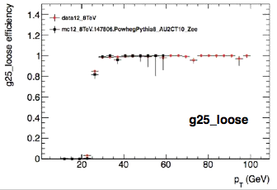
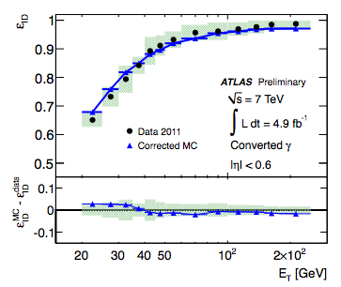
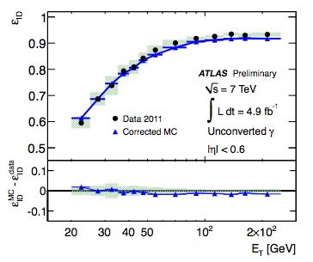
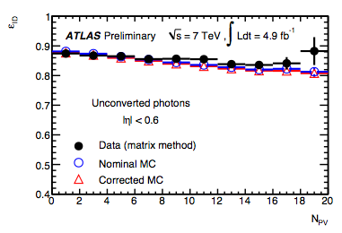
Photon
Trigger efficiency vs p_{T}
2012 unprescaled photon triggers
Trigger | Physics use | Rate (Hz) at 7x10³³
1γ: E_{T}>120 GeV, ID-loose | Multi | 12
2γ:ET>35(25) GeV, ID loose | Higgs | 14
2γ: E_{T}>20 GeV, ID-medium | SM | 5
3γ:ET>15 GeV, ID loose | SM tri-booson | 1
From Z→ eeγ events
ID efficiency vs E_{T}
Converted γ
ID efficiency vs E_{T}
Unconverted γ
ID efficiency vs “pileup”
Unconverted γ
PNPI contribution:
validation of software for photon reconstruction and identification

Slide 12
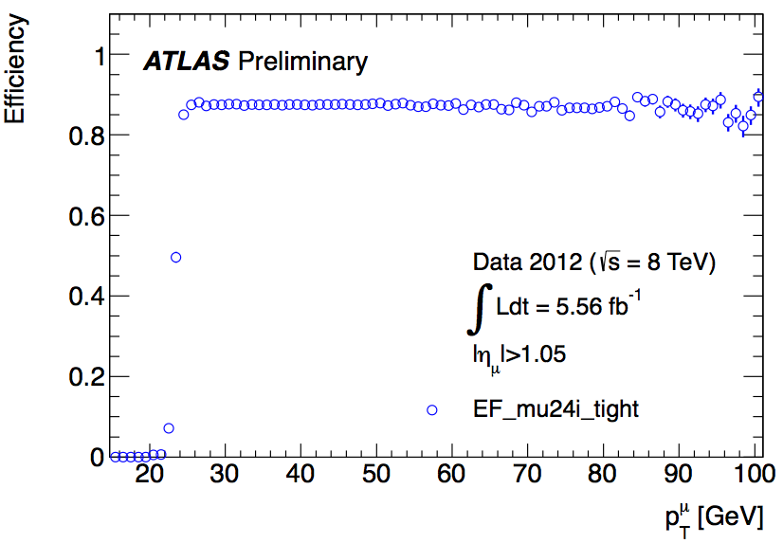
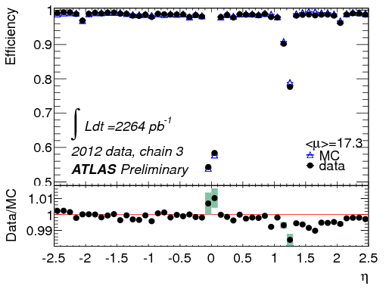
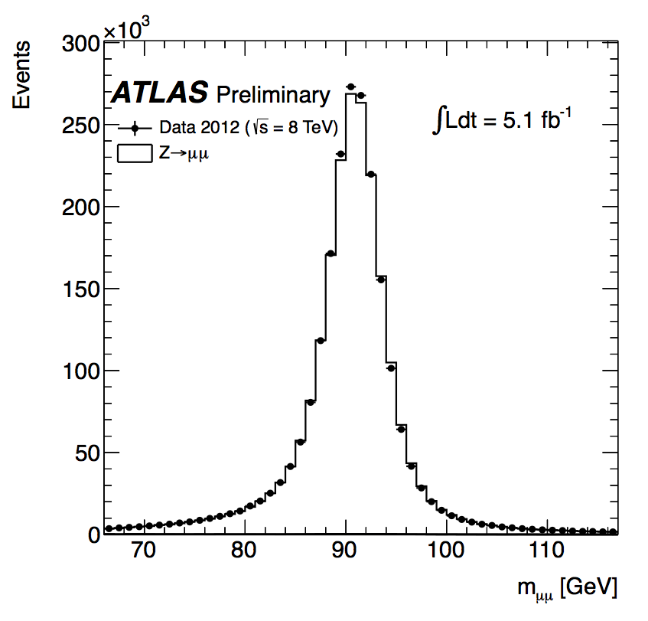
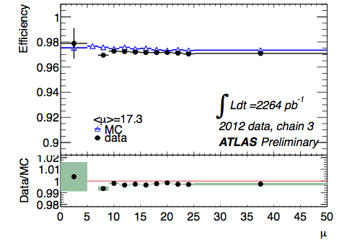
Muons
Muon trigger efficiency
Reconstruction efficiency ~ 97%,
~ flat down to p_{T} ~ 6 GeV and over |η|~2.7
end-cap
2012 Z→ μμ mass peak
Reconstruction efficiency stable to pile-up
~ 2M Z→ μμ
Mass
resolution
~ 2 GeV

Slide 13
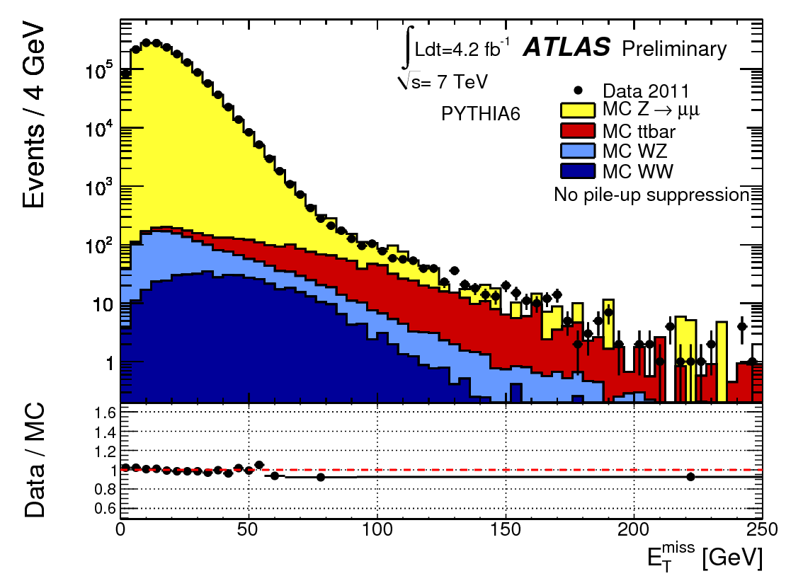
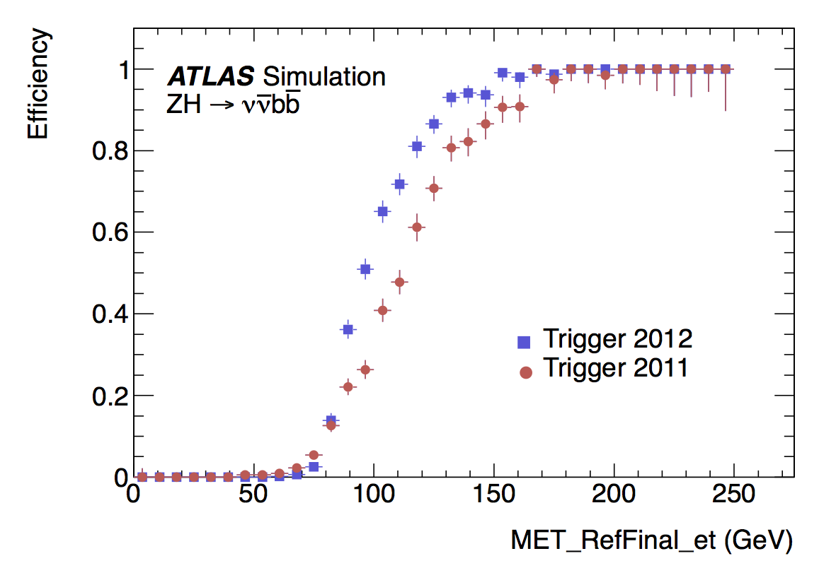
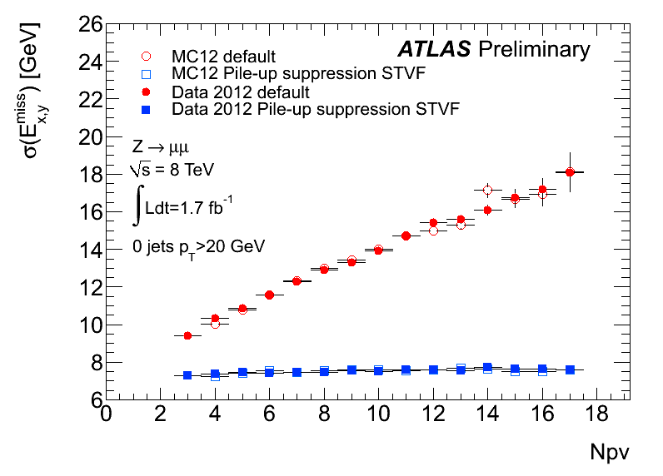
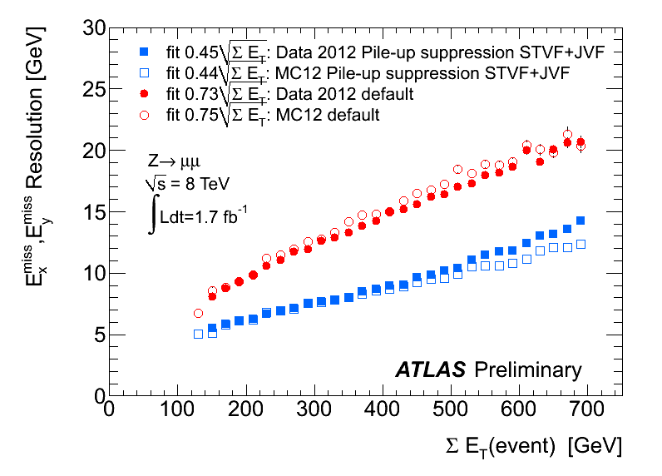
Missing E_{T}
Understanding of E_{t}^{miss} (most sensitive to pile-up) is crucial for H→ WW^{(*)} → lνlν ,
W/ZH→W/Zbb, H→ττ
2012 Z→ μμ
Many improvements in E_{T} ^{miss} trigger: e.g. pile-up suppression, L2 fast front-end board sums instead of L1 only → same threshold as in 2011, sharper turn-on curve
Offline E_{T} ^{miss} (GeV)
E_{T}^{miss} resolution vs pile-up and vs ΣET in Z→ μμ events before and after pile-up suppression using tracking information
PNPI contribution:
Control E_{t}^{miss} egamma trigger efficiency using data.
Support and development of the HLT trigger software.
Number of reconstructed primary vertices

Slide 14
Search for high-mass resonances decaying to dileptons
2 electrons invariant mass
Several models predict new resonances decaying to pairs of charged leptons or into lepton:
Spin-1 benchmarks: Z’ in Sequential Standard Model or E6 grand unified symmetry
Spin-2 benchmark: Graviton in Randall-Sundrum models
Chiral spin-1 bosons (M.V.Chizov Phys. Atom. Nucl. 71, 2096 (2008))
Expect very high-pT electrons from this signal
E_{T}>25 GeV |η| < 2.47, excluding crack 1.37<|η| < 1.52
Cuts on shower shape and track matching
A hit in the first layer of the pixel detector is required if to suppress background from photon conversions
Higher E_{T} must be isolated requiring ΣE_{T} (ΔR < 0.2) < 7 GeV – to supress QCD background
No statistically significant excess above the Standard Model expectation is observed;
Upper limits are set at the 95% CL on the cross section times branching fraction of Z′ resonances decaying into l+l− pairs as a function of the resonance mass.
As a result, Z′ bosons of the Sequential Standard Model with masses less than 2.47 TeV are excluded at 95% CL.
Z* bosons with masses less than 2.20 TeV are excluded at 95% CL (only 2011 data)

Slide 15
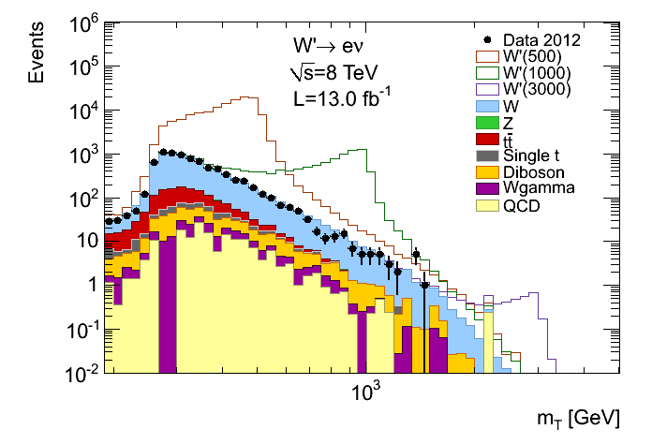
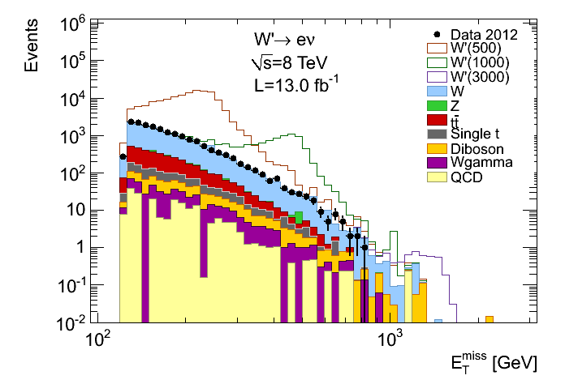
Search for high-mass resonances decaying to lepton and neutrino
m_{T} transverse mass
E_{t}^{miss} missing transverse energy
120 GeV
No yet new limits are set in 2012 data.
In 2011 data no statistically significant excess above the Standard Model expectation is observed;
Upper limits are set at the 95% CL on the cross section times branching fraction of W’′ resonances decaying into l+l− pairs as a function of the resonance mass.
As a result, W′’ bosons of the Sequential Standard Model with masses less than 2.5 TeV are excluded at 95% CL.
W* bosons with masses less than 2.38 TeV are excluded at 95% CL.

Slide 16
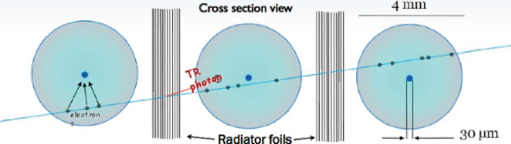
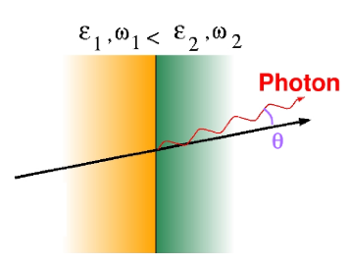
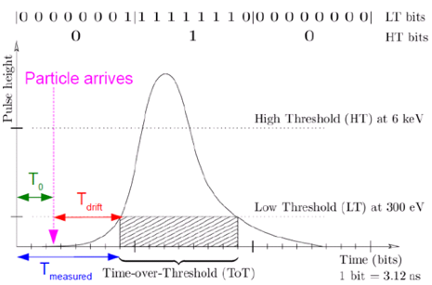
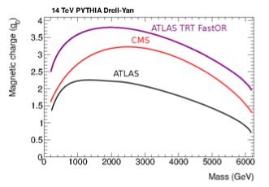
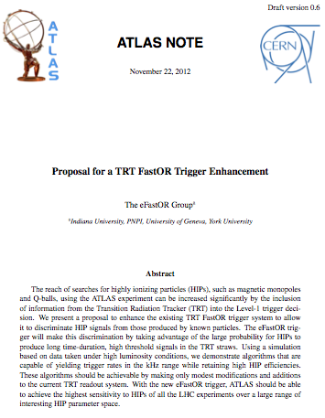
TRT eFastOR trigger
TR: photon (soft X-ray emitted by a charge particle when traversing the boundary between materials with different dielectric constants
5% acceptance for monopole
Goal is to build an enhancement to the current TRT FastOR Level-1 Trigger system that will significantly increase ATLAS sensitivity to highly ionizing particles (HIPs), such as magnetic monopoles and Q-balls.
Trigger should run within ATLAS Level-1 trigger.
eFastOR trigger takes advantage of differences in High Threshold (HT) signals from the TRT produced by known particles compared to those produced by HIPs.
Work is supported by Min Of Sci.

Slide 17
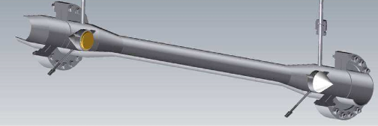
Ultrasonic vapour analyzer/flowmeter for the ATLAS silicon tracker
Sound velocity vs % concentration of C₃F₈/N₂ mixture
The vapour flow rate is calculated from the sound transit times measured parallel, t_{down}, and anti-parallel, t_{up}, to the flow direction, according to the following algorithm:
c = L/2 * ((t_{up} + t_{down})/ t_{up}* t_{down}
Mixture precision:
  ~0.3% for C3F8/C2F6
  < 10⁻⁴ for N2/C3F8
Flow resolutions of ± 2% F.S. for flows up to 250 l.min-1,
± 1.9% F.S. for linear flow velocities up to 15 ms⁻¹
View of the electronics for Utrasonic amalyzer installed in the ATLAS pit

Slide 18
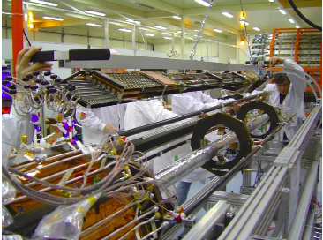
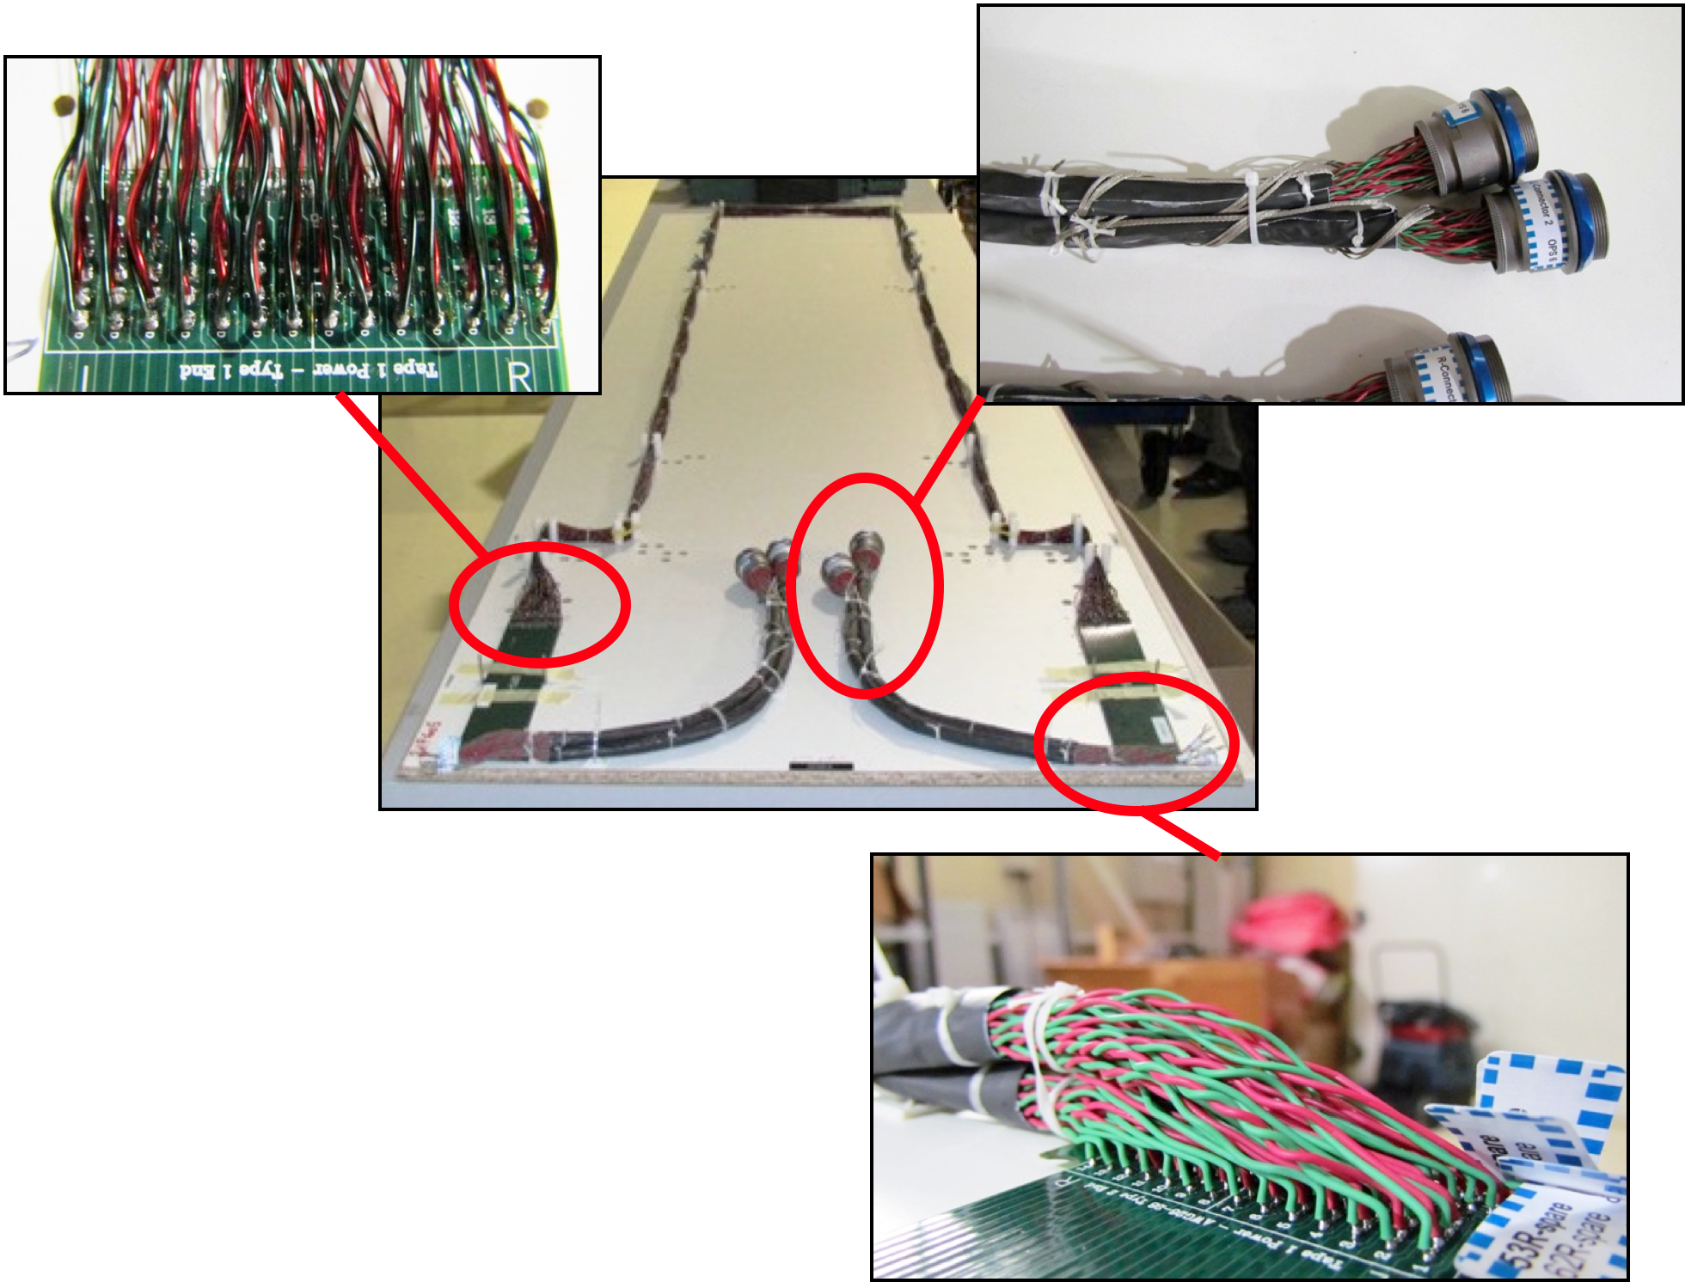
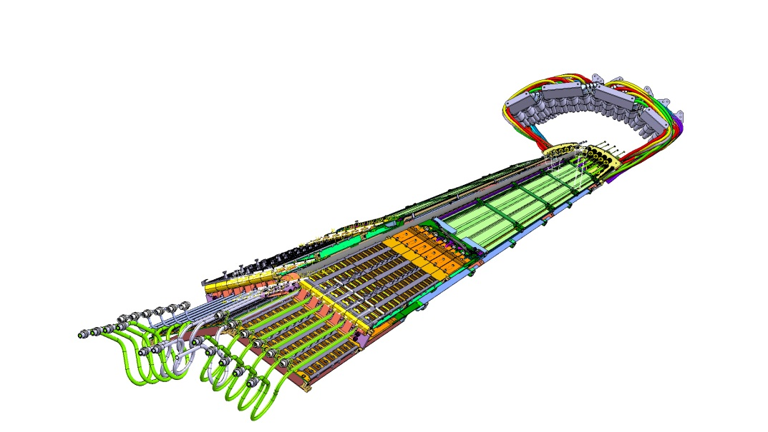
Pixel Service Quarter Panels (SQP)
Transfer services from outside world to pixel detectors
Problematic opto-couplers on SQP
To replace these need new infrastructure and electronics
Mew electronics will allow greater readout bandwidth for > 10³⁴ operation
PNPI technicians are participating in creation of the SQP

Slide 19
TDAQ/DCS
Отдел информационных технологий проф. Рябов Ю.Ф.
TDAQ Shifter assistance
TDAQ PNPI contribution :
Development and maintenance of the ATLAS data acquisition (TDAQ) system control and monitoring software at Point 1: system configuration, debugging, new features development.
TDAQ s/w release validation, maintenance (patching), s/w installation at P1, maintenance of TDAQ online infrastructure.
Development and deployment of a new automation tool “Shifter Assistant” used by TDAQ and ATLAS subdetectors at P1.
Expert (level 1,2 on-call) support for the running system at P1.
Shifts at P1: manning the Run Control desk.
DCS PNPI contribution :
  Administering and Technical support of OS Windows on DCS PCs (> 100).
  Support and improvements of:
        Rack Control system,
        DCS Access Control (including remote access),
        ATLAS – LHC Communication Interface
        Interface to Condition Database,
        CANopen OPC server – Front-end interface used by all LHC experiments.
      New development for LHC/ATLAS Upgrade
        CANOpen OPC server in advanced standard OPC UA.
      DCS Expert on-call (7/7,24/24) ~25 weeks/year.

Slide 20
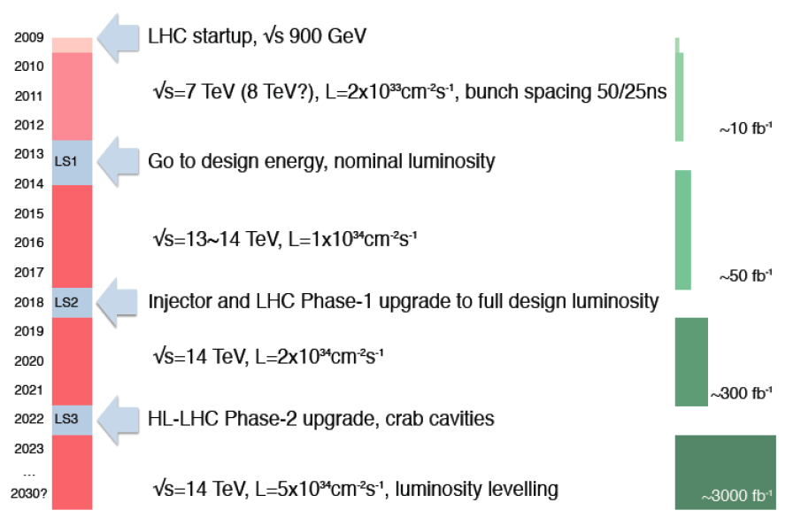
Plans for LHC Upgrade
LHC startup, √s = 900 GeV
4x
, bunch spacing 50 ns
√s=7~8 TeV, L=6x10³³ cm⁻² s⁻¹, bunch spacing 50 ns
~20-25 fb⁻¹
Go to design energy, nominal luminosity
√s=13~14 TeV, L~1x10³⁴ cm⁻² s⁻¹, bunch spacing 25 ns
, bunch spacing 25 ns
~75-100 fb⁻¹
Injector and LHC Phase-1 upgrade to ultimate design luminosity
√s=14 TeV, L~2x10³⁴ cm⁻² s⁻¹, bunch spacing 25 ns
, bunch spacing 25 ns
~350 fb⁻¹
HL-LHC Phase-2 upgrade, IR, crab cavities?
?, IR
√s=14 TeV, L=5x10³⁴ cm⁻² s⁻¹, luminosity levelling
Towards to High Energy LHC (HE-LHC) -√s=33 TeV

Slide 21
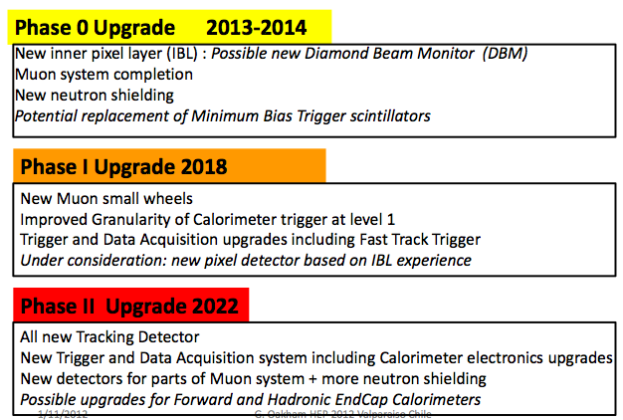
ATLAS upgrade

Slide 22
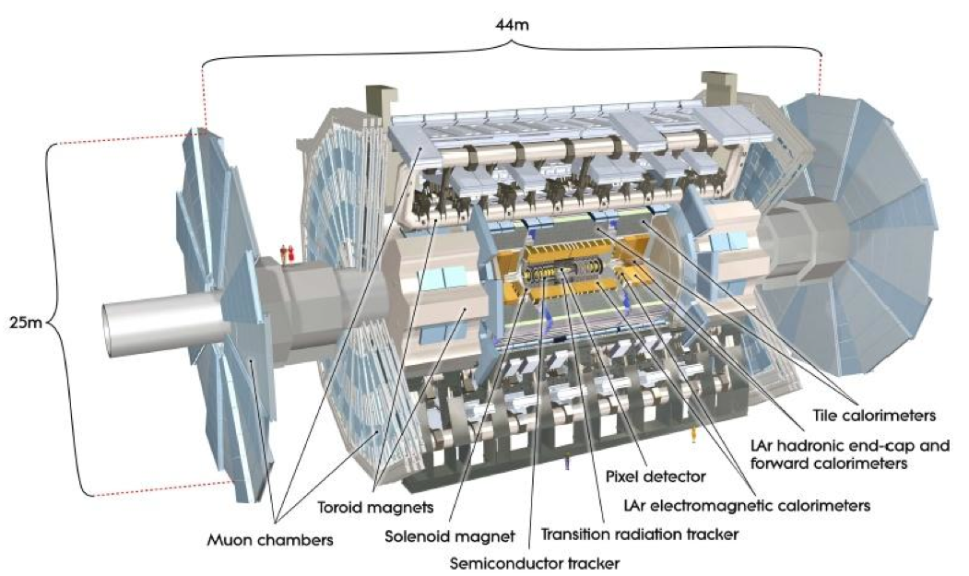
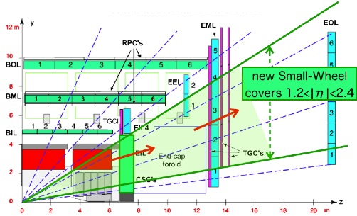
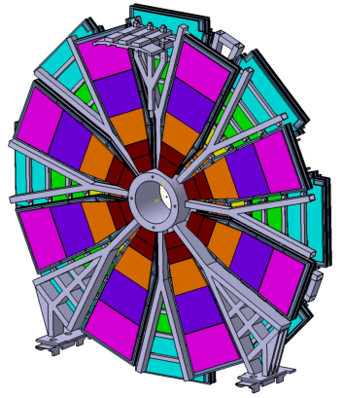

New Muon Small Wheels
Existing Small Muon Wheels: CSC and MDT (Muon Drift Tubes)
New Small Muon Wheels: sTGS and Micromegas
L1 trigger rate for L=3x10³⁴cm⁻²s⁻¹
 | p_{T}>20 GeV (kHz) | p_{T}>40 GeV (kHz)
w/o NSW | 60 | 29
w NSW | 22 | 10
Possible participation of PNPI in assembly of sTGC and front-end electronic development.

Slide 23


Slide 24
Back-up slides

Slide 25

The MC toy model for BEC
The MC toy model for Bose-Einstein correlations (BEC) has been proposed to make a best choice from different reference distributions. It occurs that the deviation from the model values of the BEC parameters is provided by the reference sample which is being emulated from "observed" sample by the turn of all momenta vectors in the transverse plane by a random angle.
In the case of the experimental data analysis the appropriate choice of the reference sample even more important.
The ATLAS data on multi-particle production with the beam energy 2.76 TeV and 7.0 TeV analyzed with the selected reference samples.
For the first time it is established that the radii of the particles radiation area is not dependent on the multiplicity , i.e. the value is saturated. The value of such radii has to be dependent on the beam energy. To make it more convincing, the data with a special trigger on high multiplicity has to be investigated with different beam energy. This is already done for the 2.76 TeV data. Such special sample is also collected with the beam energy 7 TeV. The analysis is under way.

Slide 26




TRT performance

Slide 27


TRT performance
The TRT significantly improves the momentum resolution compared to tracks reconstructed with silicon hits only
Z mass resolution in the Inner Detector shows good performance σ ~ 2.36 GeV.
Good agreement data/MC

Slide 28

Preliminary HE-LHC - parameters

Slide 29

Target parameters for
HL-LHC run
Efficiency is defined as the ratio between the annual luminosity target of 250 fb⁻¹ over the potential luminosity that can be reached with an ideal cycle run time with no stop for 150 days: t_{run}= t_{lev}+t_{dec}+t_{turn}. The turnaround time after a beam dump is taken as 5 hours, t_{decay} is 3 h while t_{lev} depends on the total beam current
baseline

