Slide 1
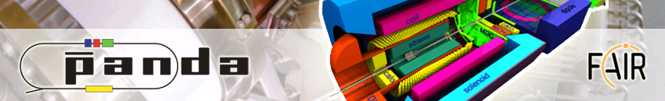



Proton Time-Like form factor measurements with PANDA
B. Ramstein, IPN Orsay, France
on behalf of the PANDA collaboration
Olympus workshop, Gatchina, July, 9th ,2012

Slide 2
Outline
The PANDA@FAIR project
Electromagnetic channels with PANDA
  pp → e⁺e⁻ at PANDA: proton time-like electromagnetic form factors
  pp → π°e⁺e⁻ reaction: time-like electromagnetic form factors in the unphysical region
  Transition Distribution Amplitudes and other measurements
Conclusion and outlook
Notes:
A changer, incorporer les corrections radiatives,….

Slide 3
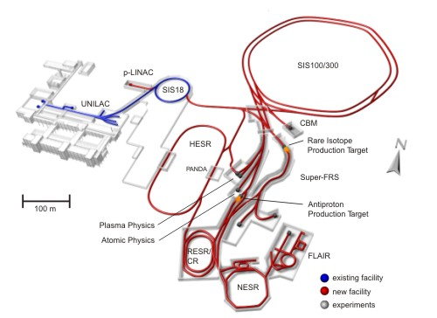
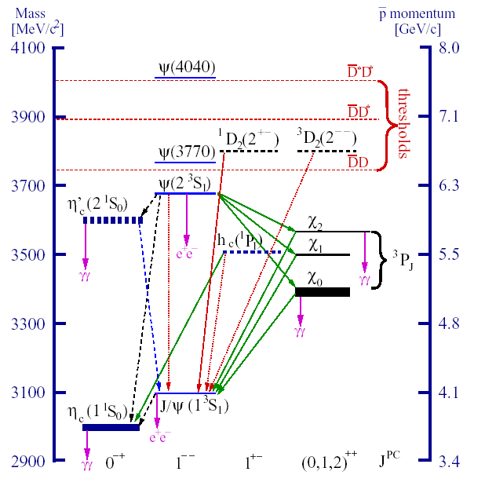
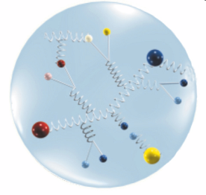
The FAIR facility (1)
Facility for Antiproton and Ion Research
Hadron Structure and Dynamics
Nuclear and quark matter
Super-heavy elements
Nuclear Structure and Astrophysics
Atomic, Plasma and Material Physics
Radiobiology
FAIR at Darmstadt/Germany
Antiproton ring
High Energy Storage
Ring 1.5 – 15 GeV/c
L = 2 x 10³² cm⁻² s⁻¹
σ_{p}/p = 10⁻⁴
2x10⁷ int.s⁻¹
Notes:
Beams p, pbar, HI

Slide 4
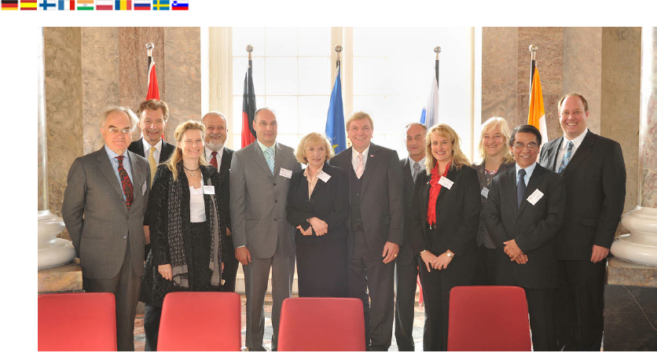
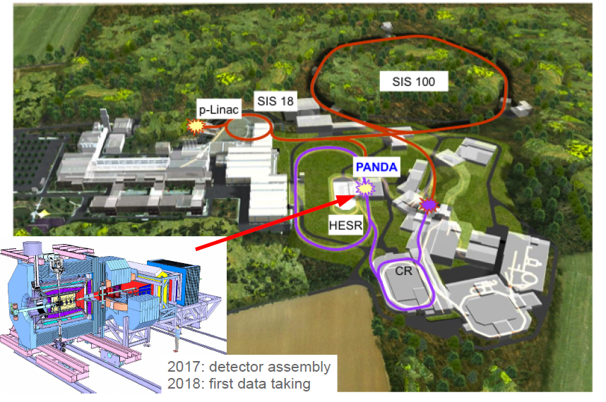
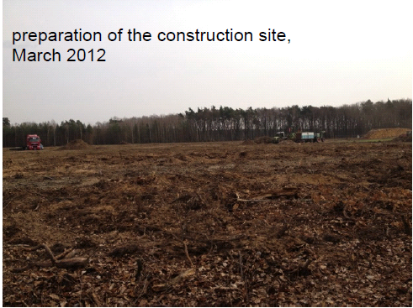
The FAIR facility (2)

Slide 5
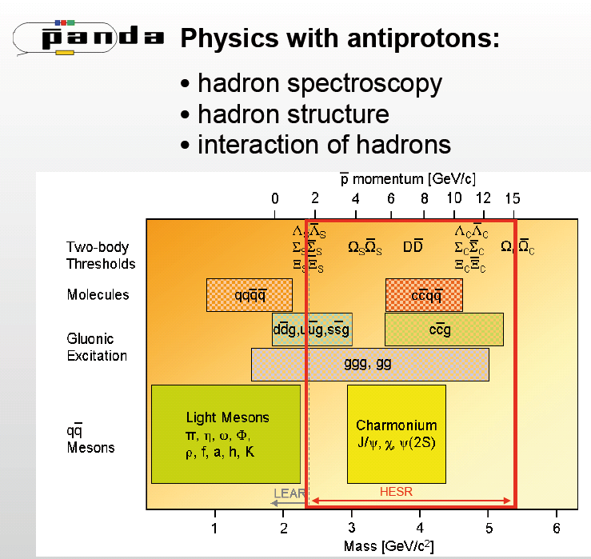
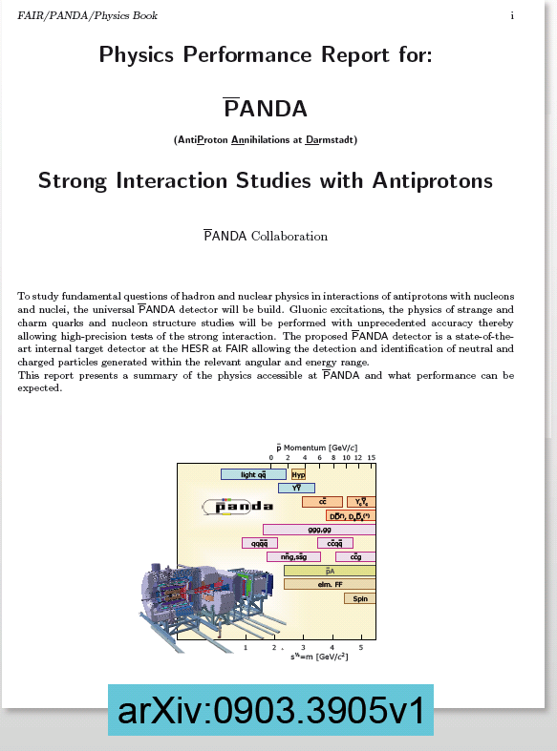

PANDA physics program
Meson spectroscopy
  D mesons
  Charmonium
  Glueballs, hybrids,
  tetraquarks, molecules,…
Charmed and multi-strange
baryon spectroscopy
Single and double hypernuclei
Hadrons in nuclear matter
Proton structure

Slide 6
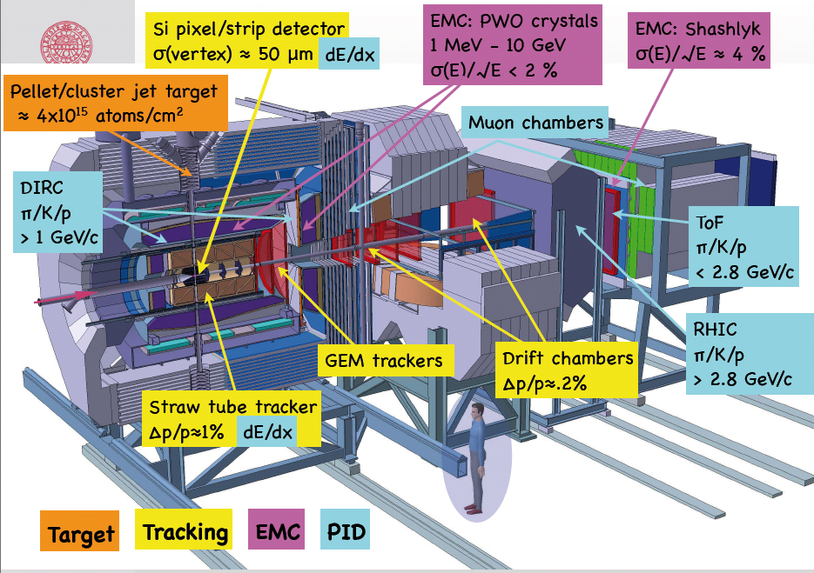
The PANDA experimental set-up

Slide 7
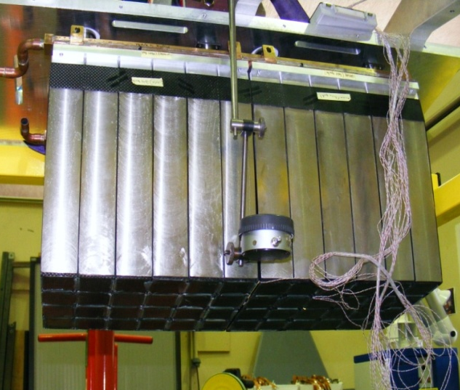
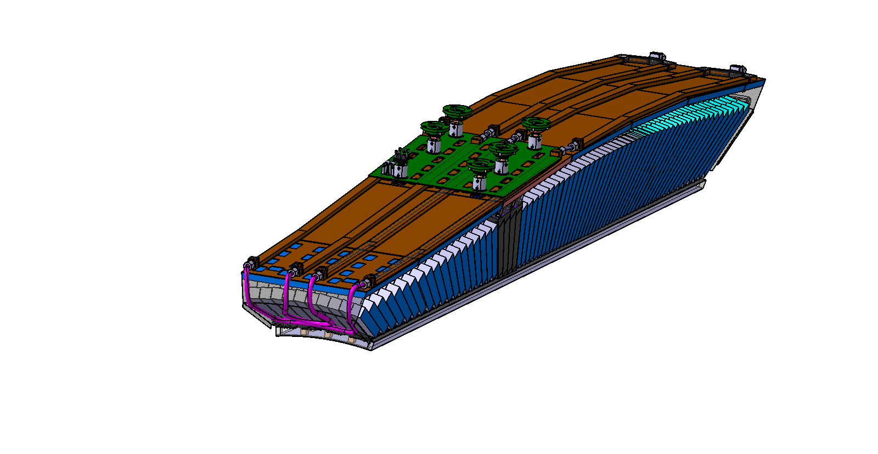
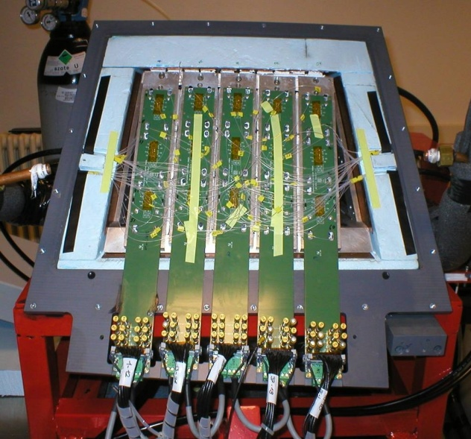
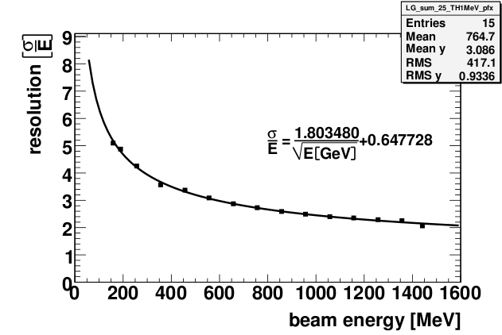
PANDA Barrel EMC
Barrel calorimeter: 11000 PbWO4 crystals
Mechanical structure: carbon alveoles + Al inserts
Proto60
  60 crystals cooled to -25°
  tests with Bremsstrahlung photons at MAMI
1 slice=
1/16 barrel
= 720 crystals
= 720 kg
σ_{E}/E = 1.8% / √E + 0.65%
Notes:
The chosen design consists in carbon alveoles fixed to Al inserts at the back end of the crystals which are themselves fixed to the magnet.
To increase the gain and the stability of the gain with respect to temperature, the crystals are cooled to -25°. Each slice will be a closed volume cooled to -25°, and specific insulation problems will have to be handled very carefully . A 60 crystals protype cooled to -25° has been built, which allowed to test the stibility of the temperature and to validate the concepts for the thermical insulation.
The prototype was also tested with real Pw04 crystals with cosmics and with Bremsstrahlung photon beams at MAMi and the resolution behaves as expected.
1’20
15’20

Slide 8















The PANDA Collaboration
At present a group of 500 physicists
from 53 institutions of 16 countries
Austria – Belaruz - China - France - Germany –India - Italy – Netherlands
Poland – Romania - Russia – Spain - Sweden – Switzerland - U.K. – U.S.A..
Basel, Beijing, Bochum, IIT Bombay, Bonn, Brescia,
IFIN Bucharest, Catania, Chicago, Cracow, IFJ PAN Cracow, Cracow UT, Dresden, Edinburg, Erlangen, Ferrara, Frankfurt, Genova, Giessen, Glasgow, GSI,
FZ Jülich, JINR Dubna, Katowice, KVI Groningen, Lanzhou, LNF, Lund, Mainz, Minsk, ITEP Moscow, MPEI Moscow,
TU München, Münster, Northwestern, BINP Novosibirsk, IPN Orsay, Pavia, Piemonte Orientale, IHEP Protvino,
PNPI St. Petersburg, KTH Stockholm, Stockholm, U Torino, INFN Torino, Torino Politecnico, Trieste, TSL Uppsala, Tübingen, Uppsala, Valencia, SINS Warsaw, TU Warsaw, SMI Wien
http://www.gsi.de/panda

Slide 9
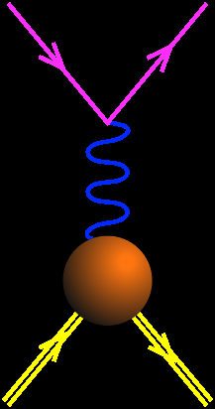
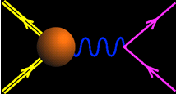
Time-Like and Space-Like electromagnetic form factors (1)
Space-like
SL
Constraints:
G_{E}^{p}(0)=1
G_{M}^{p}(0)=μ_{p}
G_{E}^{p}(4m_{p}²)= G_{M}^{p}(4m_{p}²)
Asymptotics
|G_{E,M}(q²)| ~ (q²)⁻²
e⁻
e⁻
Time-like
TL
q²<0
p
e⁻
q²>0
p+p → e⁺+e⁻ + X
Unphysical region
p
e⁺
p
p
_
Real FFs
Complex FFs
_
e+p → e+p
0
3.52 (GeV/c)²
p+p ↔ e⁺+e⁻
q²
(Phragmén-Lindelhöf theorem)
Imaginary part of Time-Like form factors vanishes for q²→+∞

Slide 10
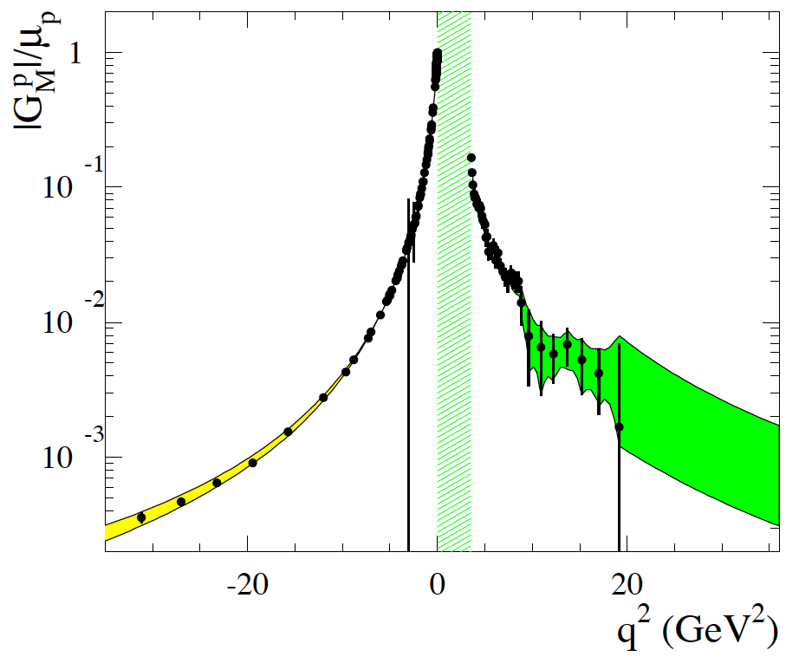
Time-Like and Space-Like electromagnetic form factors (2)
electron scattering
annihilation pp↔ e⁺e⁻
q² > 4m_{p}²
e machines ( Jlab…. A2/Mainz)
Colliders (BES, Novosibirsk, PANDA)
10⁰
Spacelike
From S. Pacetti, arXiv:1012.1232v1
10⁻¹
Timelike
^{p}
G_{M}/μ_{p}
10⁻²
unphysical
10⁻³
-30
-20
-10
0
10
20
30
Dispersion relations:
q² < 0
Notes:
I will not tell you about the situation in Space-Like region

Slide 11
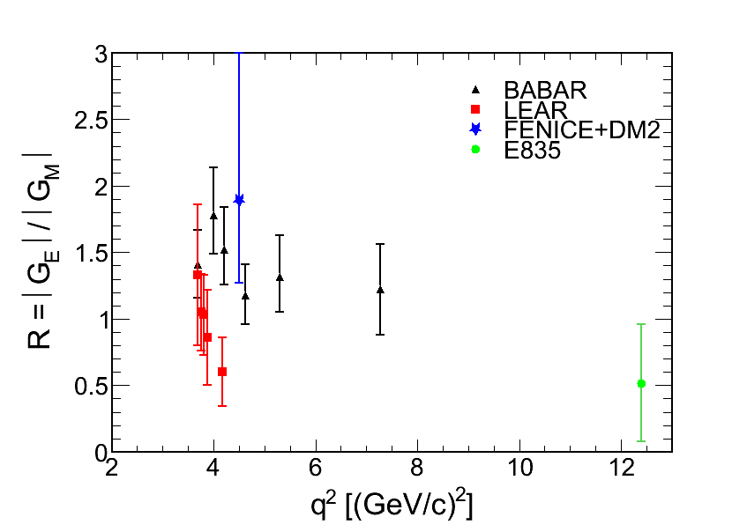
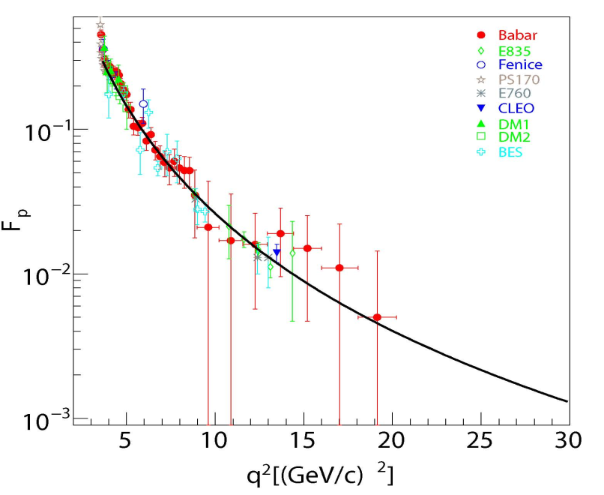
proton electromagnetic form factors in Time-Like region
-
-
Cross-sections: pp → e+e-
angular distributions: pp → e+e-
FENICE+DM2 (e+e-)
-
BABAR: (e+e- →ppγ)
-
-
LEAR (pp)
E835
(pp)
G_{eff}
4m_{p}2
G_{eff} : large error bars above 13 (GeV/c)²
|G_{E}/G_{M}| :
  Inconsistent data above threshold
  Lack of precise data above 5 (GeV/c)²
-
Notes:
In the Time-Like region, most of the experiments measured cross-sections either in epem or in pbarp annihilation , wich give access only to an effective form factor. Masurements have beeen performed up to 19 GeV/c2, but with a very poor precision. Only a few points could be obtained from angular distributions measurements, most of these points coming from the LEAR and BABAR experiments, but the precision is bad and in addition the two sets of data disagree, so that the information on the ratio of electric to magnetic form factor is rather poor in the Time-Like region.
In this context, the goal of the PANDA measurements is to measure both GE and GM up to large q2
1’10
Tot 11’10

Slide 12
Goal of PANDA measurements
Extract Time-Like |G_{E}| and |G_{M}| for proton up to 14 (GeV/c)²
from lepton angular distributions in pp →e⁺e⁻ reaction
and measure G_{eff} up to 30 (GeV/c)²
-
Two major challenges:
Decrease of sensitivity to G_{E}
with increasing q²
Huge hadronic background
σ (pp →π⁺π⁻) / σ (pp →e⁺e⁻) ~10⁶
-
-
-

Slide 13
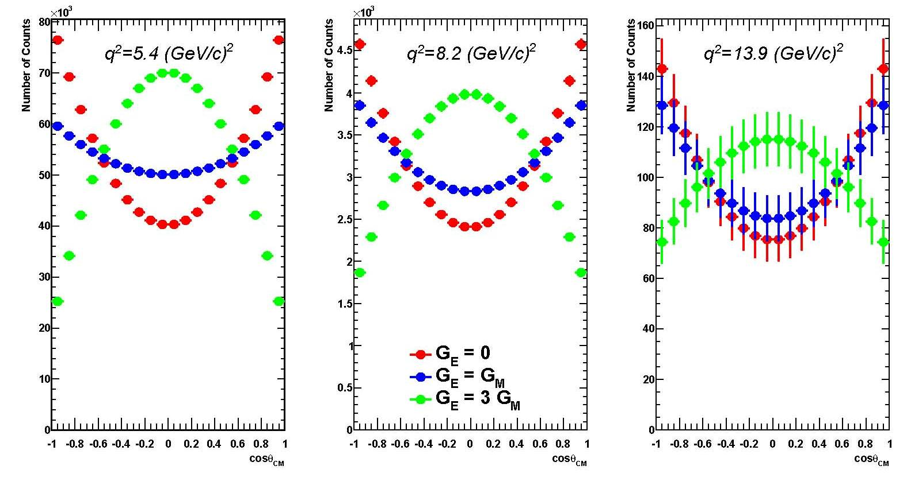
Counting rate and sensitivity to |G_{E}|
~120 days, L = 2. 10³² cm⁻²s⁻¹ = 2 fb⁻¹
Statistical errors only
G_{E}=0
G_{E}=G_{M}
G_{E}=3G_{M}
N_{tot}=1.1 10⁶ N_{tot}=64000 N_{tot}=2000
M. Sudol et al. EPJA 44 (2010) 373
Notes:
Known cross-sections, two hypothesis,
No pb with statistics, horizontal cut of the detector
The aim of this slide is to show the different regions of detection which will be relevant for the study of ppbar…Vérifier les couleurs
Divide angular distribution in bins of 0.2 in cos(theta)‏
No acceptance problem_only identification problem

Slide 14
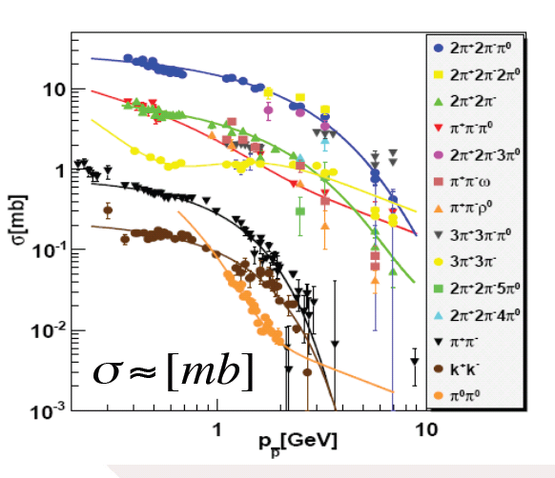
Hadronic background rejection for pp → e⁺e⁻
-
pion production
  Background rejection takes advantage of :
  Hermiticity of the detector
  Particle Identification
  Kinematical constraints
  Most problematic background is pp→ π⁺π⁻
-
Canaux chargés
Full scale GEANT simulations
for pp →e⁺e⁻ and pp→ π⁺π⁻ background
A. Dbeyssi PhD, Orsay
-
-

Slide 15
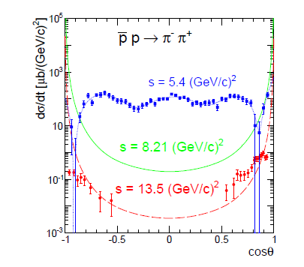
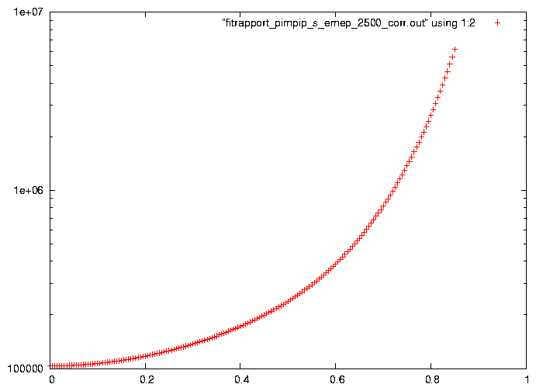
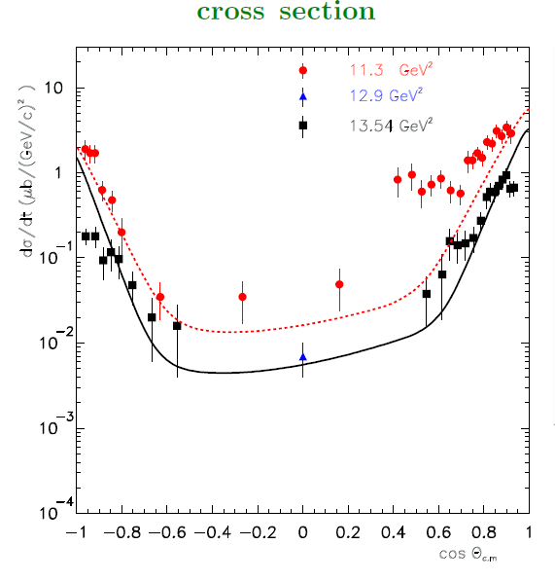
pp → π⁺π⁻
-
-
parametrization of CERN data for p p → π⁺π⁻
s < 6 (GeV/c)² : Legendre polynomial fits
s > 6 (GeV/c)² :
counting rules (Ong et Van de Wiele, IPNO-DR-08-01)
or Regge trajectories (idem, EPJA46 (2010) 291).
-
pp→ π⁺π⁻
q² = 8.21 (GeV/c)²
New measurements of p p → π⁺π⁻
will be provided by PANDA
(also important for pQCD mechanism studies)
?
2.4 10⁶
σ(π⁺π⁻)/σ(e⁺e⁻)
-
σ(π⁺π⁻)/σ(e⁺e⁻)
1.5 10⁵
cosθ_{CM}

Slide 16
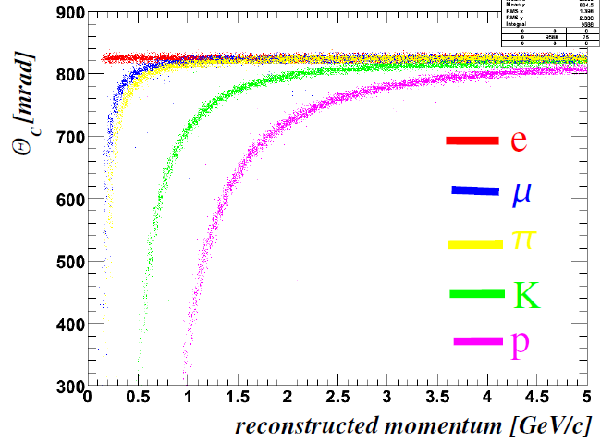
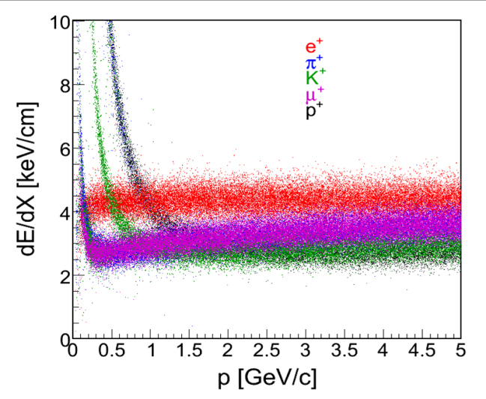
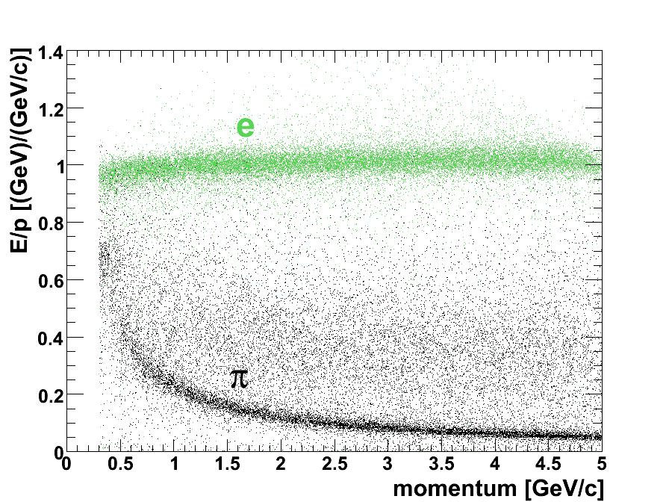
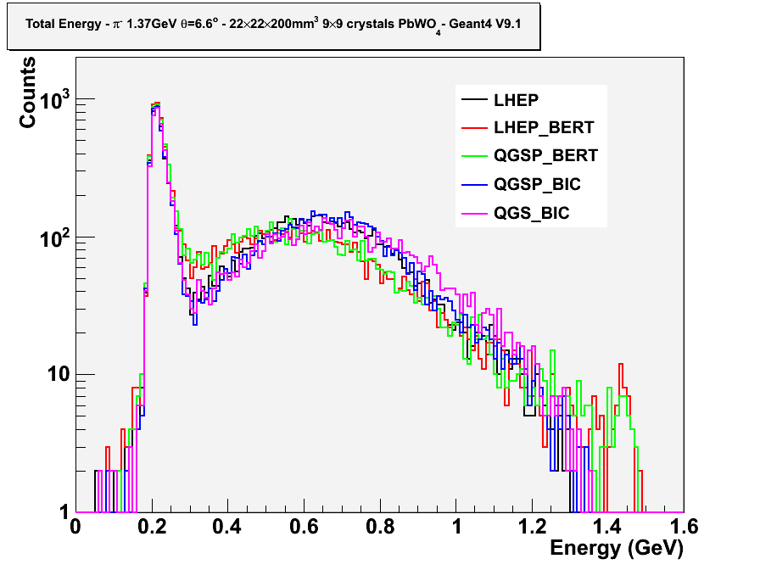
Rejection of pp → π⁺π⁻
DIRC(Cerenkov)
Straw Tube Tracker
ElectroMagneticCalorimeter
(π⁻ , π°) , π°→ 2γ
E_{dep}/p ~ 1
Non-gaussian tails of truncated dE/dx distribution
EMC response to π⁻ p=1.5 GeV/c
1) Use complementarity of e/π discrimination
capability of the different detectors
2) Use the different kinematical constraints
of pp → e⁺e⁻ and pp → π⁺π⁻ reactions
_
_
Electron momentum resolution (bremstrahlung )
B. Ramstein (IPN Orsay)
16
T.Zerguerras, IPN Orsay
Notes:
16
To achieve such high rejection factors, the complementarity of the different detectors with respect to PID is exploited. The DIRC detector, which measures a Cerenkov angle in a quartz rod provides an efficient e/pi discrimination at low momentum, but the discrimination power vanishes above 1-1.5 GeV/c. The measurements of DE/dx in the central traker are rather powerful over a large range of momenta, while for the electromagnetic calorimeter, the discrimination power obtained by the ratio of E/p is much better at higher momenta. The electrons deposit all their energy in the calorimeter, so they have E/p close to 1. The pion line here is due to the energy loss by ionisation, but a large fraction of the pions undergo hadronic interactions. This is seen clearly on this spectrum which shows the energy deposit of a pion at a momentum p=1.5 GeV/c. The peak is due to energy loss by ionization and a broad bump due to the hadronic interactions. The highest energy deposit are due to the charge exchange process. Indeed, a high energy pi0 is created and the energy of the 2 gammas have a high probability to leave all their energy in the calorimeter. In order to make realistic estimates for e/pi discrimination, we therefore need a model that do not underestimate this charge exchange reactions. As you can see here, different models have been tested and the most pessimistic model is chosen for the simulations. This model is the Bertini cascade and which is also known to be one of the most realistic models to describe hadronic showers, for example, it has been tested recently with the CMS calorimeter and gives good results.

Slide 17
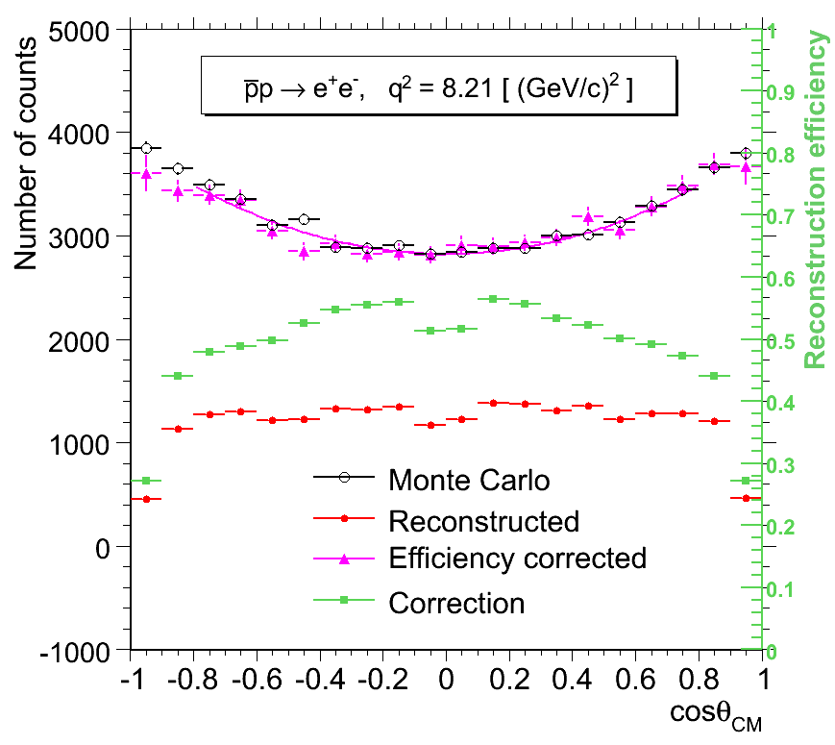
pp →e⁺e⁻ signal reconstruction
-
Sudol et al. EPJA 44 (2010) 373
q² π⁺π⁻
[GeV/c]² contamination
8.2 0.004 %
12.9 0.017 %
16.7 0.061 %
→ contamination < 0.1 %
Background suppression factor is at
least of the order of 10⁹
Taking into account PID & kinematic fit
contamination <<1%

Slide 18
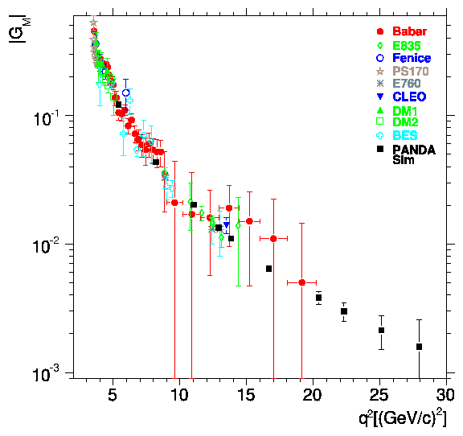
Time-Like Form Factor measurement with PANDA : precision estimates
L=2 fb⁻¹
Courtesy of S. Pacetti
Sudol et al. EPJA 44 (2010) 373
E. Tomasi-Gustafsson and M.P. Rekalo, PLB504,291
E. Tomasi-Gustafsson, arXIv:0907.4442
G_{eff}
PANDA
PANDA
BES
BES
< 1% ~10% ~23% ~50%
pQCD ?
Phragmèn-Lindelöf theorem ?
Notes:
In this publication, we also evaluate the precision on the form factor measurement that will be achieved with PANDA and compare it to the existing data. The ratio of electric to magn FF can be measured up to 14 GeV/c2 from an analysis of the angular distributions with a good precision. This will improve very much the present experimental situation. In addition, it will allow to discriminate among models which are all able to reproduce the Geff and also the space like data, but give different predictions for the ratio GE/GM. Here we see for example the Iachello model in green, which predicts a very strong electric form factor.
Cross-sections and therefore the effective form factor can be measured with good precision up to 30 GeV/c2, which is the maximum available q2 at PANDA.

Slide 19
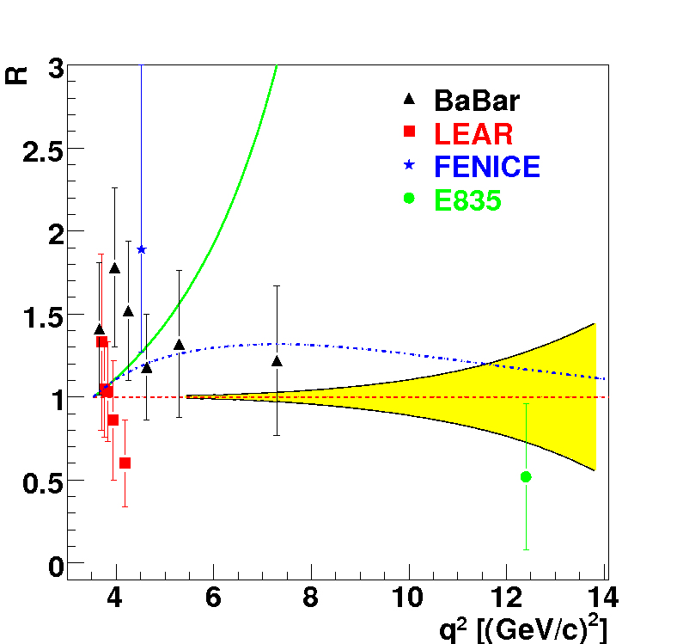
Time-Like Form Factor measurement with PANDA : precision estimates
L=2 fb⁻¹
Sudol et al. EPJA 44 (2010) 373
-VDM: F. Iachello et al., PLB43, 171 (1973)
…extended VDM, PRC66, 045501 (2002)
Egle Tomasi-Gustafsson et al., EPJA24 (2005) 419
G_{eff}
PANDA
PANDA
BES
BES
< 1% ~10% ~23% ~50%
pQCD ?
PANDA will bring
Precise determination of |G_{E}| and | G_{M} | up to 14 (GeV/c)²
G_{eff} up to 30 (GeV/c)² : transition towards perturbative QCD
Notes:
In this publication, we also evaluate the precision on the form factor measurement that will be achieved with PANDA and compare it to the existing data. The ratio of electric to magn FF can be measured up to 14 GeV/c2 from an analysis of the angular distributions with a good precision. This will improve very much the present experimental situation. In addition, it will allow to discriminate among models which are all able to reproduce the Geff and also the space like data, but give different predictions for the ratio GE/GM. Here we see for example the Iachello model in green, which predicts a very strong electric form factor.
Cross-sections and therefore the effective form factor can be measured with good precision up to 30 GeV/c2, which is the maximum available q2 at PANDA.

Slide 20


2γ contributions and radiative corrections
Rosenbluth
method
Important role of 2γ
exchange and
radiative corrections
Polarization
measurements
?
No C-odd terms
contribution
C-odd terms
contribution
-
Advantage of annihilation reactions pp ↔ e⁺e⁻
The e⁺ and e⁻ angular distributions are measured in the same experiment
PANDA measurements are sensitive to odd cos θ terms
dσ/dcosθ_{e} ~ A (1+ b cosθ_{e}sin² θ_{e} + c cos²θ_{e}+..) with b=5% or more
(M. Sudol et al EPJA 44(2010) 373).
Notes:
Mettre

Slide 21
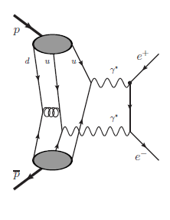
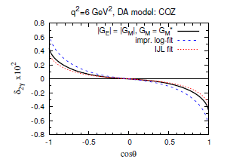

-
2γ contributions in pp → e⁺e⁻
  Model independent properties on cross sections and polarization observables : G. Gakh and E. Tomasi-Gustafsson NPA761(2005)120.
  see E. Tomasi-Gustafsson’s talk
2γ contributions at large q² in a factorization approach
J. Guttmann, N. Kivel, M, Vanderhaeghen PRD83 (2011) 094021
see N. Kivel’s talk
Distribution
Amplitudes
resonant contribution:
H.-Q . Zhou and B.S. Zou .arXiv:1112.4615v2

Slide 22
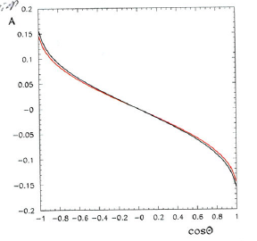
radiative corrections for pp → e⁺e⁻
-
  IPN Orsay et al. contributions: A. Ahmadov et al., Phys.Rev.D82:094016,2010
  J. Van de Wiele and S. Ong, arXiv:1202.1114v1 [nucl-th]
Small contribution of box terms
e⁺ angular distribution
Born
δ~-15%
for E_{γ cut}=100 MeV
angle dependent effect
Full calculation
Final state radiation only
Important effect of interference
between proton and lepton radiation
Charge asymmetry
J. Van de Wiele ans S. Ong, arXiv:1202.1114v1 [nucl-th]
Event generators with photon emission for PANDA experiments

Slide 23
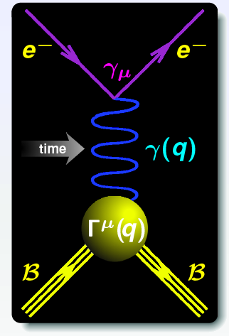
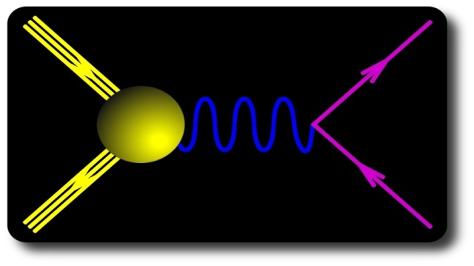


Time-Like form factors in the unphysical region (1)
Dispersion relations
q² < 0
Space Like (SL)
-
pp ↔ e⁺e⁻ annihilation
Time Like (TL)
q² < 0
p
γ(q)
e⁺
q² = s
q² > 4m_{p}²
Unphysical region
p p → e+ e- π0
p
Г^{μ}(q)
p
p
e⁻
|
FFs real
FFs complex
4m_{p}²
q²
Vector meson poles: q² = m²_{ρ}, m²_{ω}, m²_{φ}
Vector Meson Dominance (VMD)
form factor models can be tested

Slide 24
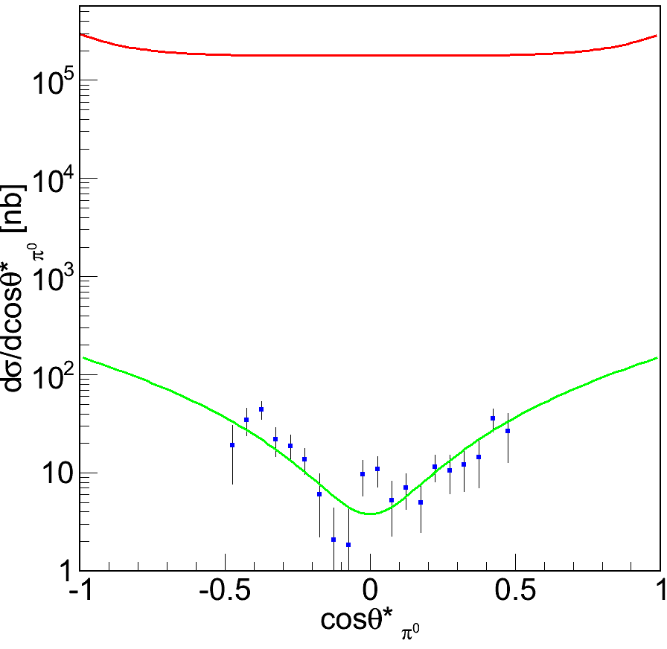
Form factors in the unphysical region (2)
Basic idea: reach q² < 4 m_{p}² by giving 4-momentum to another particle (e.g. π⁰)
M. P. Rekalo, Sov. J. Nucl. Phys., vol1, 760 (1965)
-
p
q2
e+
e-
p p → e⁺ e⁻ π⁰
|
p
+ exch.
1st calculation of dσ/dq2 for
A. Dubnickova et al,. Z.Phys. C70 (1996) 473-482
C. Adamuščín et al., Phys. Rev. C 75, 045205, 2007
π°
New investigations by J. Van de Wiele and J. Boucher in IPN Orsay to build an event generator for simulation studies
    d5σ / dq2dθ_{π0}dϕ_{π0} dθ _{e}dϕ_{e}
    constrained on existing data
Recent calculation of d5σ / dq2dθ_{π0}dϕ_{π0} dθ _{e}dϕ_{e}
and polarization observables
G.I. Gakh et al. arXiv:1206.0929
data: Fermilab E760
for p p → π⁰γ
√s=3.005 GeV
-
Armstrong et al.,PRD56,(1997)2509

Slide 25
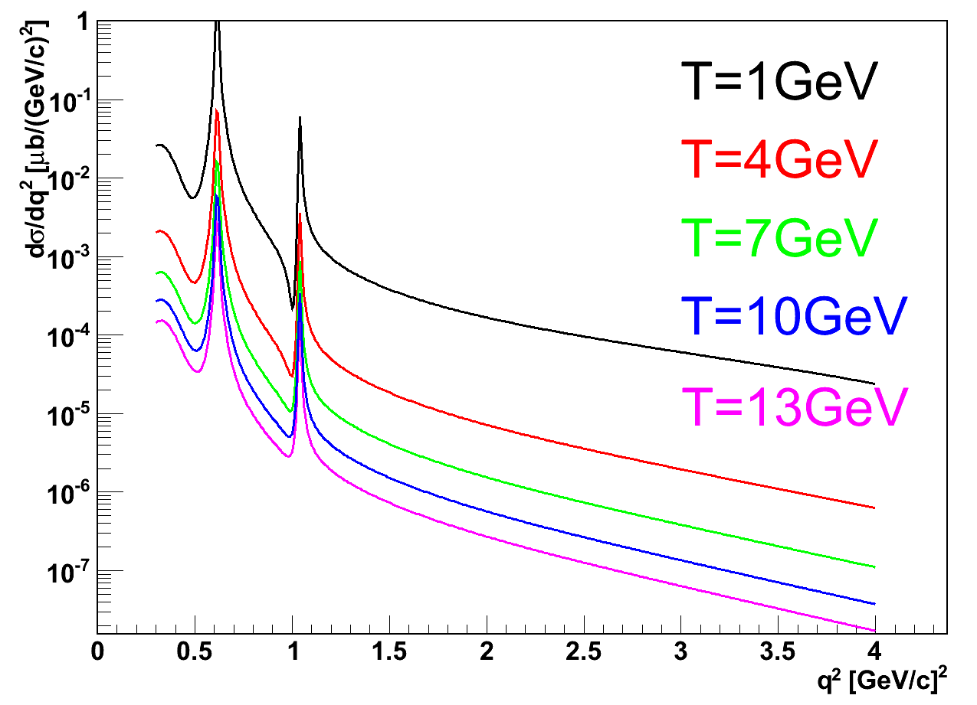
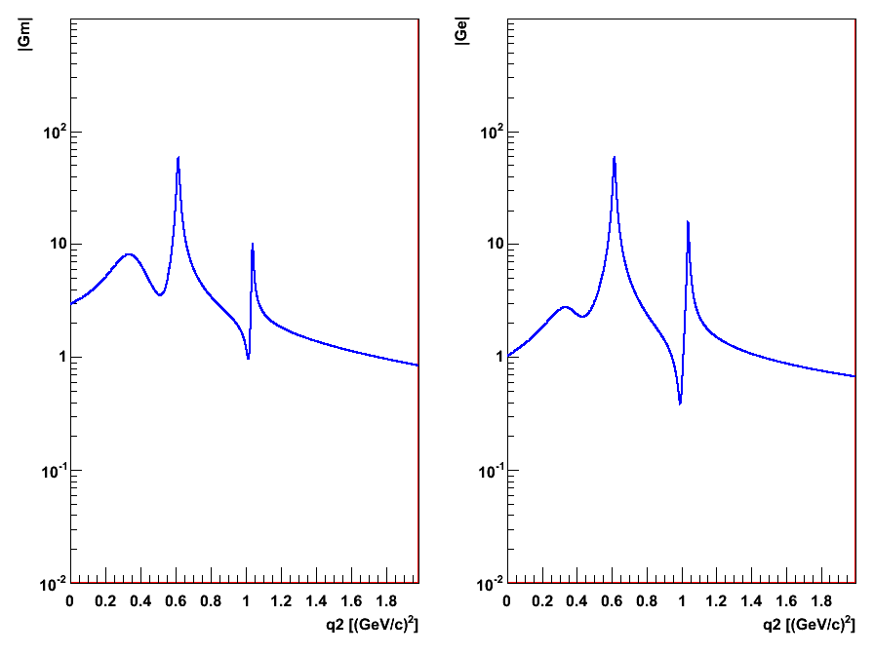
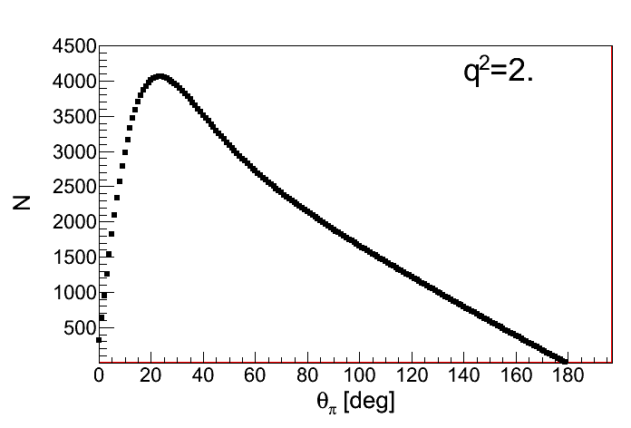
Count rate predictions for pp →π⁰e⁺e⁻
Iachello VMD form factor model
Phys. Rev. C69, 055204, 2004
Incident energy dependence
ρ, ω and φ resonances
|G_{M}|
|G_{E}|
q² (GeV/c2)
q² (GeV/c2)
Luminosity =2 fb-1
-
p
q2
e+
T=1GeV
q²=2.±0.25 (GeV/c)²
e-
p
π°
at T=1 GeV , q²=2 (GeV/c)²
172000 events for Δq²=0.5 (GeV/c)²,
4000 events for Δθ_{π}=1° (θ_{π}=20°)
J. Boucher PhD Orsay dec.2011

Slide 26
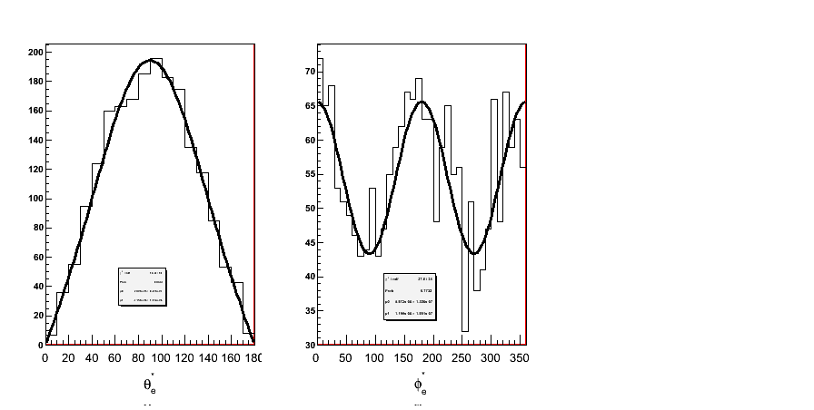
-
From hadronic tensors to form factors
How to extract G_{E} and G_{M} in p p → e+ e- π0 ?
-
p
q2
e+
e+
γ*
θ_{e}
e-
p
+ exch.
π°
e-
dσ/dφ_{e}
J. Boucher PhD Orsay dec. 2011
In the one nucleon exchange model :
dσ/dθ_{e}
dσ/dφ_{e}
For fixed θ_{π0} and q²,
Fit of lepton angular distributions in γ* frame
→ R=|G_{E}/G_{M}| and cos(ϕ_{E}-ϕ_{M})
θ_{e+} (deg)
φ_{e+} (deg)
General result: the angular distribution in θ_{e}* and φ_{e}* in γ* frame
gives access to 4 H_{μν} at fixed θ_{π0} and q²

Slide 27
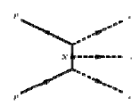
-
Background for pp →π⁰e⁺e⁻
  Background rejection takes advantage of :
  Hermiticity of the detector
  Particle Identification
  Kinematical constraints
  Most problematic background is pp→ π⁺π⁻π⁰
-
-
pp → π⁺π⁻ π⁰
Calculation for T=1 GeV
J. Van de Wiele, IPN Orsay
Effective lagrangians: 9 graphs in total
+
+ …
at T=1 GeV , q²=0.6 (GeV/c)² σ_{B}/σ_{S}=3-5.10³
q²=2 (GeV/c)² σ_{B}/σ_{S}=3.10⁶⁻3.10⁷ → input for simulations
-
N.B. PANDA will provide new measurements of pp→ π⁺π⁻π⁰

Slide 28
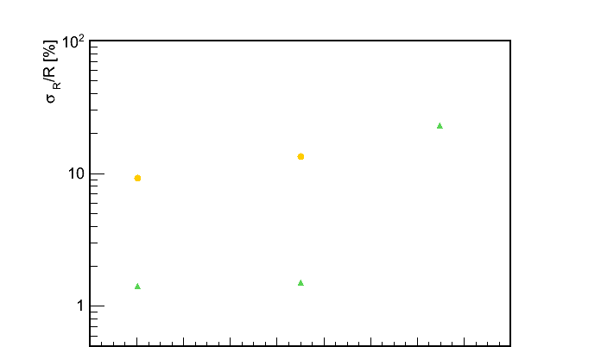
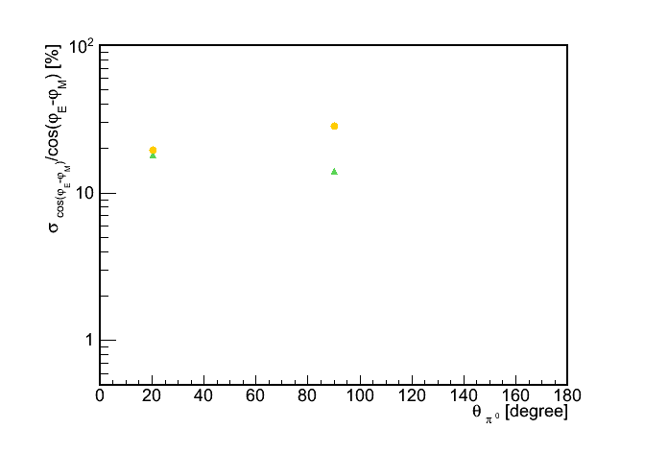
Expected precision on |G_{E}|/|G_{M}| and the phase difference
p p → e⁺ e⁻ π⁰
|
q²=0.605 ± 0.005 (GeV/c²)²
|G_{E}|/|G_{M}|
q²=2.0 ± 0.125 (GeV/c²)²
σ_{R}/R [%]
q²=2
Signal contamination <1 % at q²=0.6
< 10% at q²=2.0
q²=0.605
~ 1% precision close to the ω resonance
~ 10% precision at q² =2 (GeV/c²)²
~ 20% precision at q²= 4M_{p}² =3.52 (GeV/c²)²
q²=2
q²=0.6
σ_{cos(δφ)} /cos(δφ) [%]
For the first time cos(φ_{E}-φ_{M}) can be extracted with 10-30% precision
cos(ϕ_{E}-ϕ_{M})
T. Hennino, J. Boucher, IPN Orsay

Slide 29
Form factor measurement in the unphysical region: outlook
The measurement of electromagnetic form factors moduli and phase difference below 4m_{p}² threshold in pp →π⁰e⁺e⁻ , following the one nucleon exchange model is feasible
However: there are open questions:
  off-shell effects on form factor
  Validity of the nucleon exchange model ,
    role of Δ exchange
    importance of s-channel terms
    E.A. Kuraev et al. arXiv:1012.5720v2 [hep-ph]
  → can be checked with pp →π⁰γ measurement at PANDA
-
-
p
q2
e+
e-
p
π°
-

Slide 30
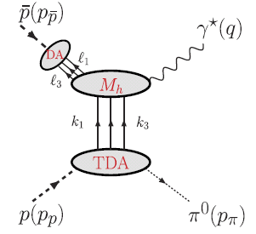
Another approach for the pp→e⁺e⁻π⁰ reaction : Transition Distribution Amplitudes
-
Hard sub-process :
Signature: Angular distribution of the e⁺/e⁻ in the γ* frame
~ (1+ cos²θ)
Distribution Amplitude = 3-quark operator matrix element
<0|uud|p>
q²>>1
Transition Distribution Amplitude = 3-quark operator matrix element
<π|uud|p>
θ_{π}=0⁰ or θ_{π} = 180⁰
‘π’ at rest in p or pbar rest frame
Δ_{t}=(p_{p/p}-p_{π})_{t}=0 → 3 TDA
-
J.P. Lansberg et al, PRC76,111502(2007)
New window on the sea quarks in proton wave function
complementary to corresponding quantities from CLAS/JLAB
Notes:
Approach of pbarp->e+e-pi0.
Peut-etre signaler que cela peut etre mesure en bckwd meson electroproduction a JLAB.
Also possible est mis aussi dans le slide suivant.

Slide 31
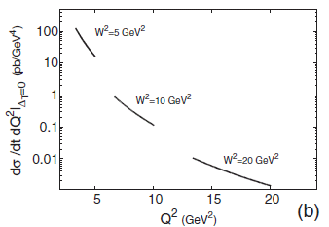
Transition Distribution Amplitudes in pp→e⁺e⁻π⁰ reaction : estimates for PANDA
-
J.P. Lansberg et al, PRC76,111502(2007)
-
T_{p}=0.788 GeV
Estimates for PANDA: ( Mainz/Orsay collaboration
M.C. Mora Espi, B. Ma) including acceptance and efficiency
L= 2 fb⁻¹ , ΔQ² < 1 GeV²
→ Feasible at s=W²=5 (GeV/c)^{2,} but probably not at W²=10 (GeV/c)²
-
T_{p}=3.5 GeV
also to be studied
pp→J/Ψ π⁰ (same TDA’s)
Possible generalization to η and ρ (more TDAs)
-

Slide 32
Nucleon structure and pQCD with PANDA
More about electromagnetic Time-Like proton form factors
  pp → μ⁺μ⁻ (collaboration with Torino)
  pd → n e⁺e⁻ H. Fonvieille and V. Karmanov, EPJA42 (2009)287
  Polarization in pp → e⁺e⁻ → relative phase of G_{E} and G_{M}
Other electromagnetic processes:
  pp → γγ, pp → γπ° (GDA, Giessen)
  pp → e⁺e⁻π° (Transition Distribution Amplitude p→π)
  pp → μ⁺μ⁻ X ( Drell-Yan, Torino/Ferrara)
Panda Physics Performance arXiv:0903.3905 [hep-ex]
-
-
-
-
-
-
-
Notes:
There are a lot of other measurements with PANDA, which are related either to nucleon structure or to perturbative QCD mechanisms. Time-Like proton form factors can be measured in pbarp -> mu+ mu- and we will study that channel soon in collaboration with Torino group.
A feasibility study is on-going on the reaction pbarp going to e+e-pi0 to study form factors below the ppbar threshold, following the idea by

Slide 33
Conclusion and outlook
The PANDA detector at FAIR will allow for a variety of QCD studies, from 2018
Electromagnetic channel measurements :
  pp → e⁺e⁻ Proton Time-like Form factors :
  G_{E} and G_{M} up to q²=14 (GeV/c)^{2 ,,} Geff up to 30 (GeV/c)²
  and pp → π⁰e⁺e⁻ : access to form factors in the unphysical region
  pp → e⁺e⁻π⁰, pp → J/Ψ π^{0 ,}pp → e⁺e⁻ρ , pp → e⁺e⁻η (TDA)
  pp → γπ⁰, γ γ General Distribution Amplitudes
  complementary to JLAB/CLAS
  pp → µ⁺µ⁻X Drell-Yann
Simultaneous measurement of hadronic channels: ( π⁺ π⁻, π⁺ π⁻ π ⁰,….)
  background for electromagnetic channels
  Interest for pQCD mechanisms

Slide 34
Thanks
PANDA/IPN Orsay team: J. Boucher, A. Dbeyssi, M. Gumberidze, T. Hennino, R. Kunne, T. Liu, B. Ma, D. Marchand, S. Ong,
E. Tomasi-Gustafsson, J. Van de Wiele
in collaboration with Mainz/GSI
Thank you for your attention !

Slide 35
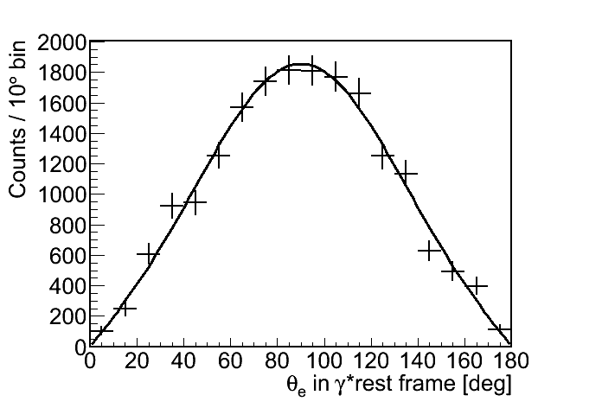
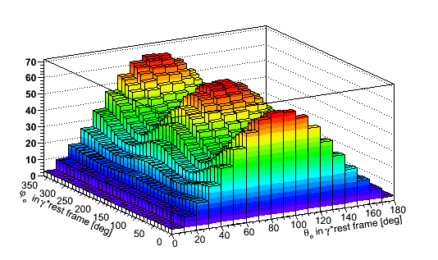
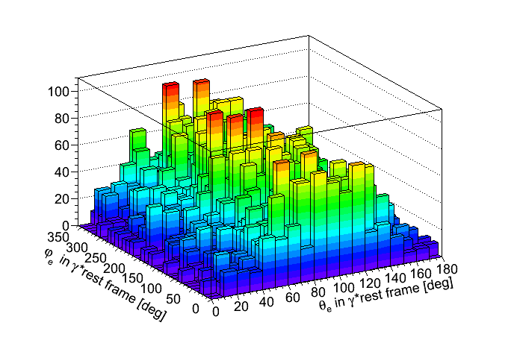
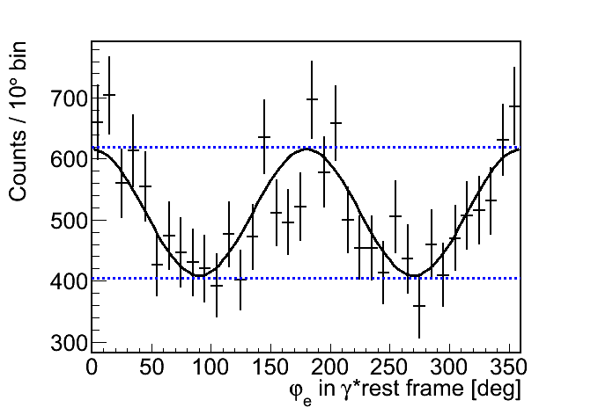

From experimental to physical information
T_{p}=1 GeV ; q²=2.0 ± 0.125 (GeV/c²)² ;
10°<θ_{π°}<30°;
N^{th}=18 486
→H₁₁+H₂₂-2H₃₃
Predicted e⁺ distribution in γ*
Corrected experimental distribution
Full simulation chain
Projection
and fit
→H₁₁-H₂₂
Determination of
R=|G_{E}|/|G_{M}| and cos(φ_{E}-φ_{M})
from the shapes only
→H₁₁-H₂₂ and H₁₃
Notes:
Le detail sur les projections peut etre enleve.

Slide 36
Hadronic channels
understand the reaction mechanism and the transition towards pQCD
-
-
-
pp → π+π- ,
pp → π+π- π0
pp → K+K- ,
only low quality data exist from CERN
High statistics expected at PANDA, easy to measure
needed anyway to control the background for proton form factor measurements in and reactions
theoretical work: J. Van de Wiele and S. Ong EPJA46 (2010) 291: models checked on existing data to be used as generators for simulations
-
-
pp → π+π- ,
pp → π+π- π0
-
-
pp → e+e-
pp → e+e-π0
Possibility to explore
up to -t=30 (GeV/c)2
With PANDA

Slide 37

Hadronic tensor extraction: proof of principle
T_{p}=1GeV
q²=2.0 ± 0.125 (GeV/c²)²
L_{int} = 2 fb⁻¹
d²σ/dΩ_{e}* generated in the γ* rest frame (θ_{e}*, φ_{e}* in10°/bin)
Reconstructed value from the fit of d²σ/dΩ_{e}* in each θ_{π0} interval (Δθ_{π0}=1°)
H₁₁
H₂₂
Theoretical value
Reconstructed value
H₃₃
H₁₃
Direct access to H_{μν} via the angular distribution valid whatever the model is
Only statistical errors without acceptance nor efficiency
Notes:
La-aussi remettre la reaction et un graphe. To determine.
Experimental determination of Hmunu as a function of theta_pi0.
Je mettrais lint a cote de tp et q2: ce sont les conditions de la simul
Les textes bleus et rouges sont un peu longs et calculation et fitted value pas forcement explicite.
Tu pourrais mettre en bleu theoretical value et en rouge: reconstructed value.
Et a gauche, en rouge, reconstructed value from the fit of electron angular distributions in each theta_pi0 interval.
Theoretical value et reconstructed value from the fite

